Slide 1
Performance Evaluation of Efficient Interpretable Attention Inception Model for Redshift Estimation
Snigdha Sen
MAHE, Bengaluru Campus
Date: 10/01/2025

Slide 2
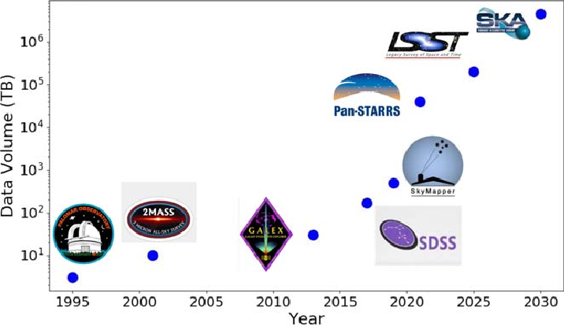
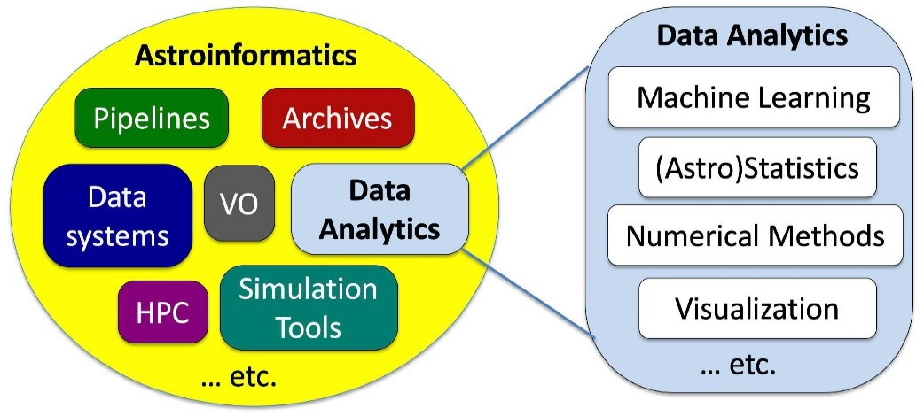
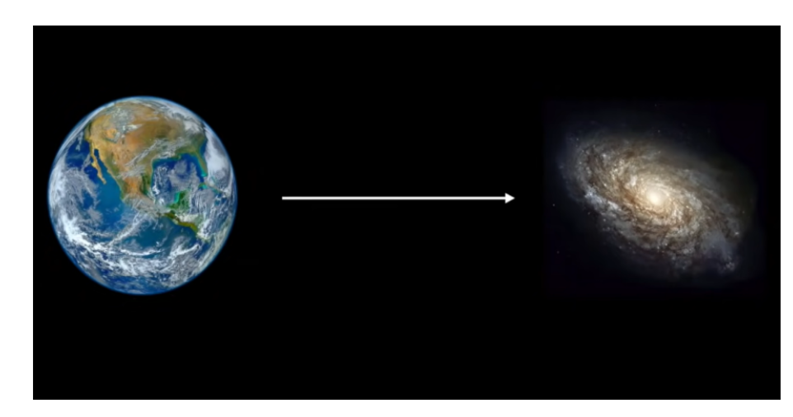
Data Driven Astronomy – A Game Changer
Why Redshift Estimation is Important?
Distance Measurement
Expansion of the Universe
Understanding Cosmic Evolution and building 3D map of the Universe
Source: http://astroinformatics.info/astroinfo
Astronomical
Data
Cloud for Storage + Machine Learning+ Deep Learning
Big Data
Evolution of Astronomical Surveys Data Volumes. Maireles-González et al., 2023
Accelerating growth of Cosmological Discovery
AWS SageMaker- Cloud Platform

Slide 3
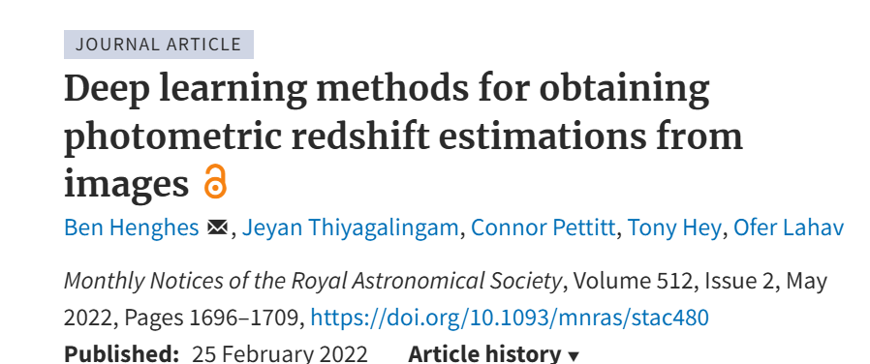
Handling Mixed Input Data
Dealing with Images
Motivation of This Work
Traditional ML methods use extracted catalogs of magnitudes
Deep learning algorithms could extract far more information from images than from the magnitude features alone.
We experiment with a variant of mixed-input model that use both images and magnitudes as inputs
We designed separate input data and running through networks in parallel before combining the networks by concatenation. Mixed-input models are a combination of two separate models
Collaborator: Ambuj Kumar Pandit, TCS

Slide 4
Handling Mixed Input Data
Contribution
Proposed model provides better bias and Outlier% compared to existing models on our dataset
Proposed model converges faster in a smaller number of epochs compared to the baseline
Interpretability analysis of the proposed model has been carried out to understand crucial factors behind the prediction using a Saliency map and SHAP analysis
Magnitude features
Preprocessing
Centre crop 32*32*5
Training set
Load image data (64*64*5)
Converting to Tensor
Horizonal/Vertical Flip
Attention-Inception Model + MLP
Explainability
Performance analysis
Testing set
Train model

Slide 5
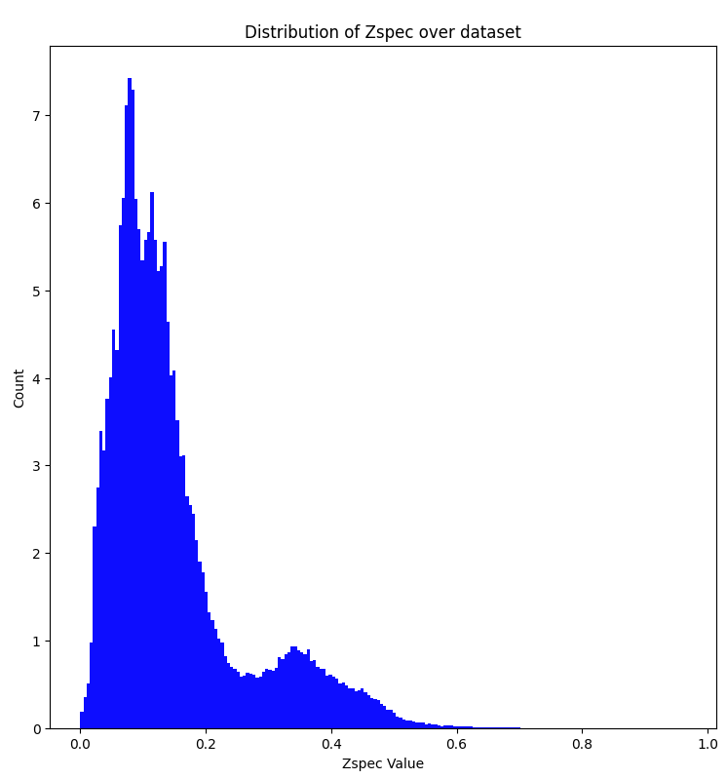
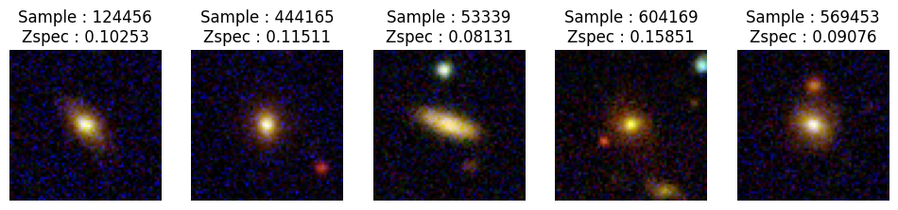
Handling Mixed Input Data
Dataset
The ugriz band image is derived from the SDSS DR 12 of Main galaxy sample
Dataset consisting of galaxy images together with the spectroscopic redshift provided by Pasquet et al. 2019
50 GB made of individual samples of size 64x64x5
It contains 659857 samples over the redshift range of 0 - 0.6.
Sample image and redshift distribution

Slide 6
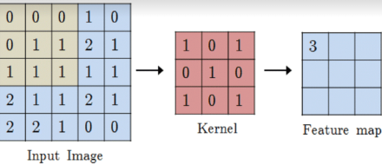
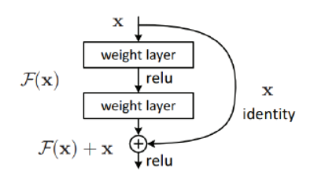
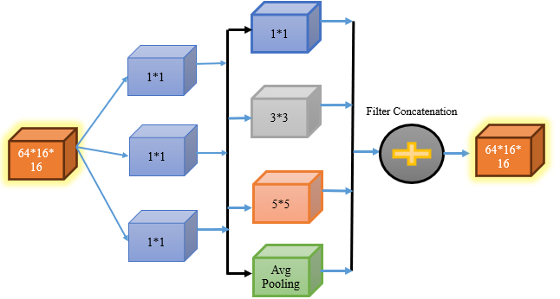
Model Development
Inception Block
Skip Connection which connects the input directly to output thereby reducing the bottleneck in the deep neural networks and improve gradient flow
Inception blocks are made of convolutional and pooling layer which are organized in two stages.
In the first stage, the input features are convolved with three 1x1 convolution layers
In the second stage, the output of those feature maps from the first stage are processed in parallel with a pooling layer, 3x3 convolution layer and 5 × 5 convolution layer respectively to help identify larger patterns
By traversing multiple paths, they are able to recognize features which differ in scale
Convolution operation
Inception framework

Slide 7
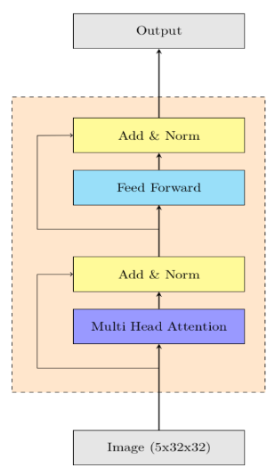
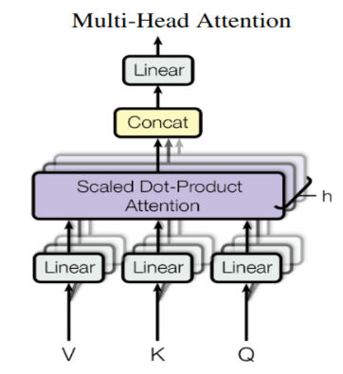
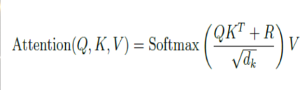
Model Development
Transformer Block
First introduced in the paper “attention is all you need” by A. Vaswani which revolutionized the NLP domain
It is made of Multi Head attention with feed forward network arranged with Layer Norm together with skip connections as shown in the schematic
For the image task, we first flatten the image to make it a sequence as transformers work for sequence to sequence generation task.
With flattened image, we create query, key and value matrices by multiplying input sequence with the matrices made with learnable parameters
After passing through the whole block, we reshape the output sequence to the original shape of the image.
Transformer Architecture

Slide 8
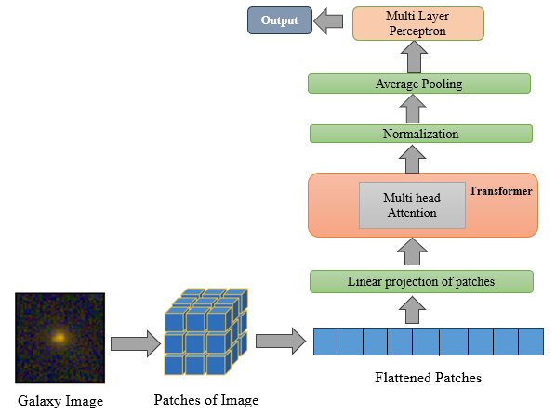
Model Development
Workflow - Schematic
Attention mechanisms allow the model to selectively focus on the parts of the input that are most important for making a prediction, and to ignore the less relevant parts
Image is represented in the form of patches
By applying self-attention across these patches, the model can capture interactions between different regions of the image
Flatten the patches and Create a sequence and feed the sequence as a input to encoder of transformer
Q, K, and V represent the query, key, and value matrices which are obtained from the input feature.
R is the relative position encoding matrix which Is precomputed. R captures the relative positions between different elements in the sequence so as to avoid external embeddings
We calculate attention for each query & key in the input using the formula and apply the SoftMax function to obtain “importance” probabilities

Slide 9
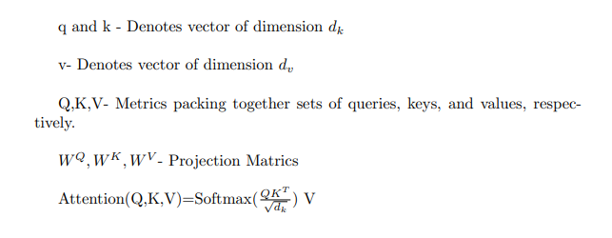
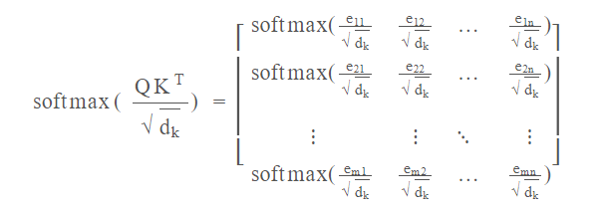
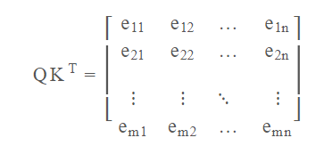
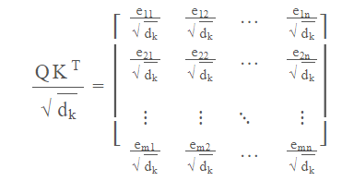
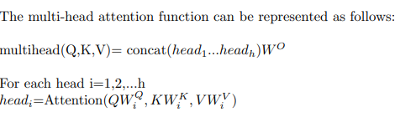
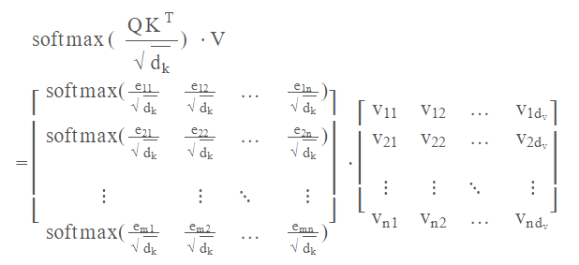
Model Development
Attention Mechanism

Slide 10
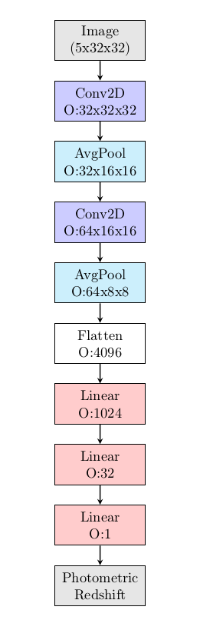
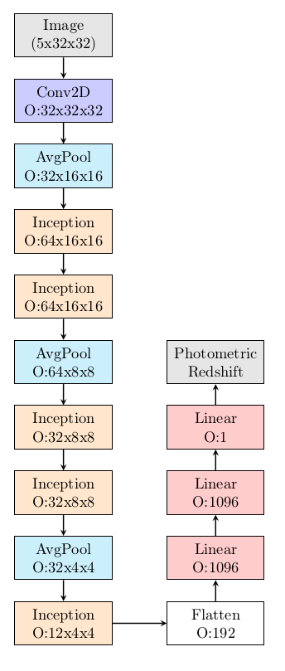
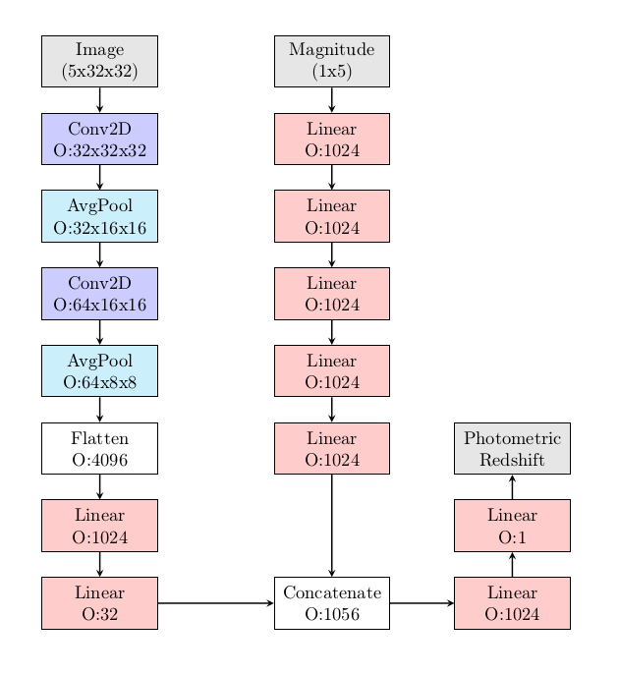
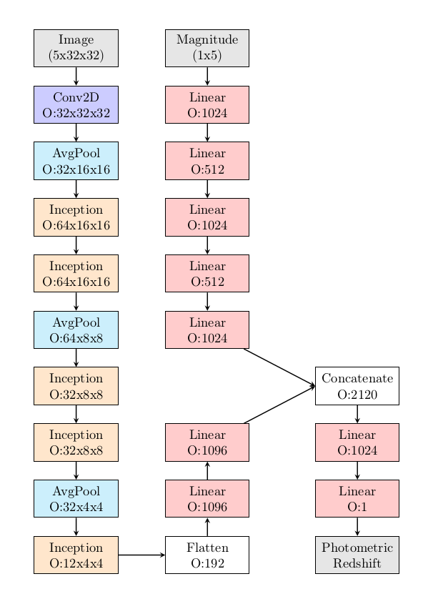
Baseline Models
A3 model
A4 model
A1 model
A2 model
Ben Henghes and others, Deep learning methods for obtaining photometric redshift estimations from images, Monthly Notices of the Royal Astronomical Society, Volume 512, Issue 2, May 2022, Pages 1696–1709, https://doi.org/10.1093/mnras/stac480

Slide 11
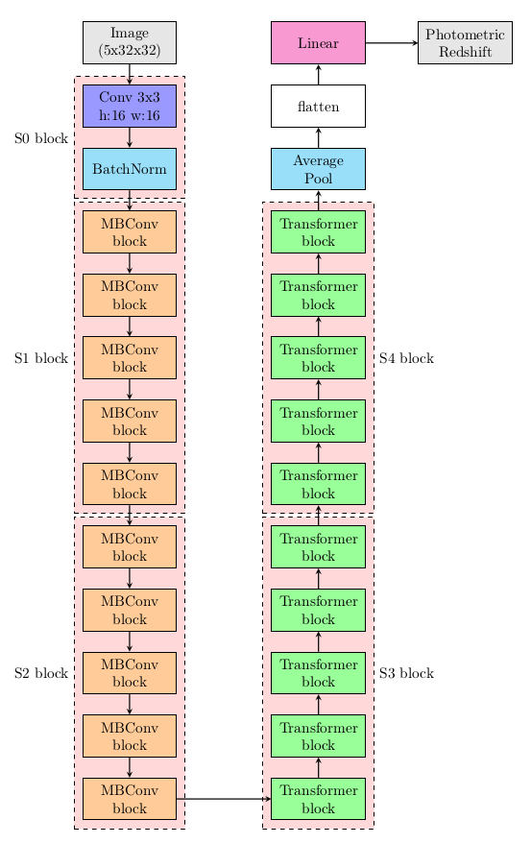
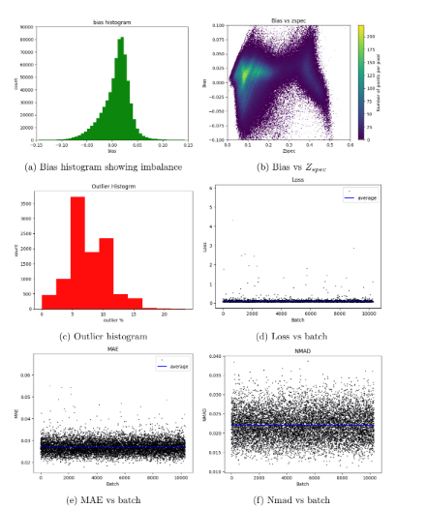
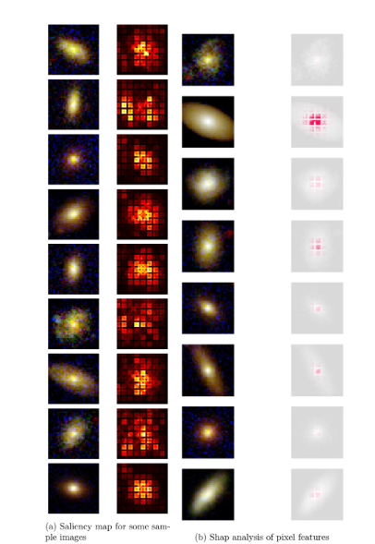
Experiment with CoatNet Model
CoAtNet model with CCTT design

Slide 12
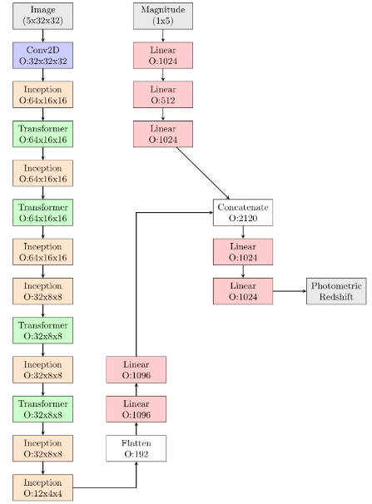
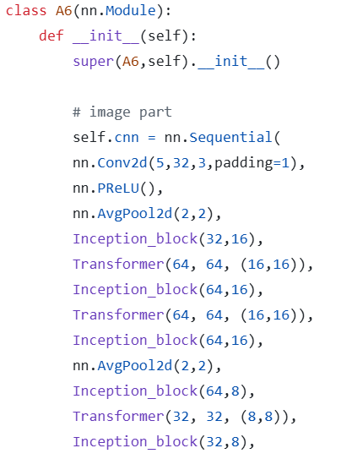
Proposed Framework
MB convolution layer from the CoAtNet was discarded and Inception block is introduced.
Transformer- Large Model Capacity
Self-attention mechanism captures long-range dependencies
Global relationship within an image

Slide 13
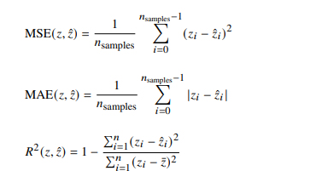


Model Training
Hyperparameters
Evaluation Metrics
The batch size is kept as 64 and MSE is used as the loss function
Step LR function that reduces it after a fixed number of steps to 0.2 times it’s original value
The split is 80-20 resulting in 527885 training and 131972 testing samples
Parametric relu (PReLU)
Maximum number of epochs is capped at 100
The optimized learning rate obtained after many runs is in range of .0001

Slide 14
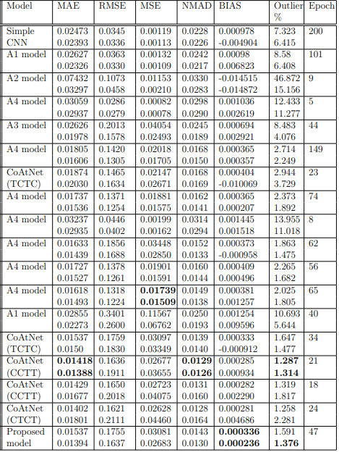
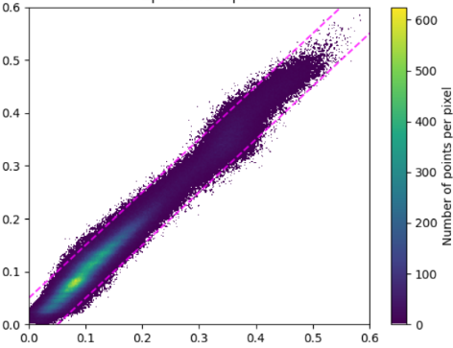
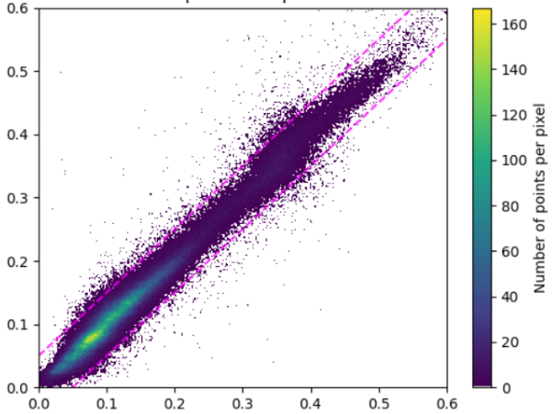
Experimental Results
Pytorch framework
Nvidia© RTX 3050 GPU with 4.0 Gb vram.
Zphot
Zspec
Zspec
Training and Testing

Slide 15
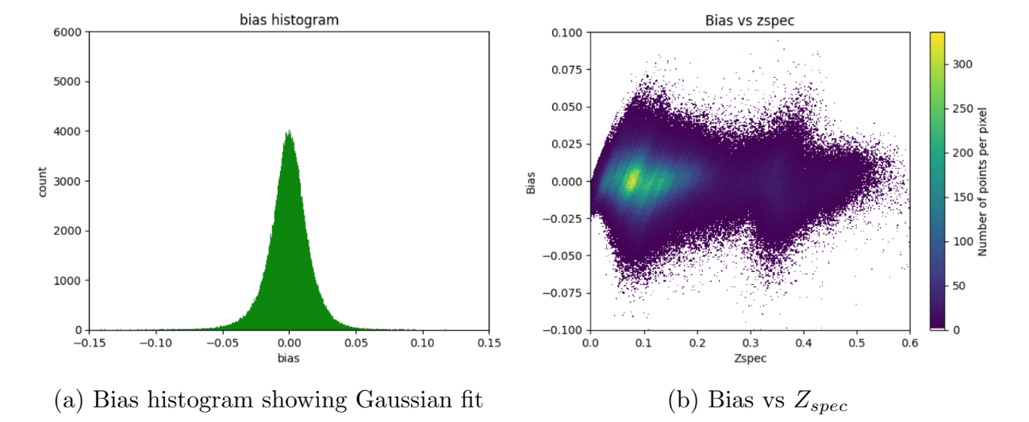
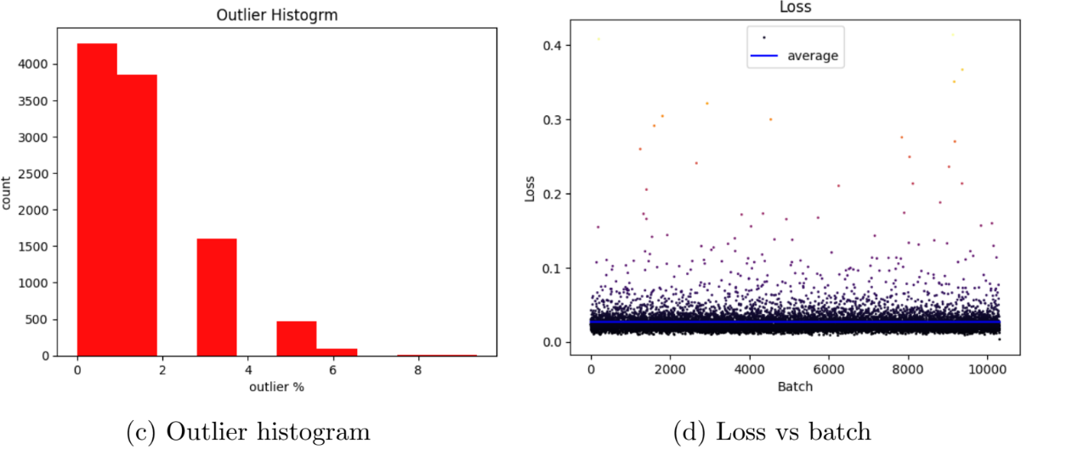
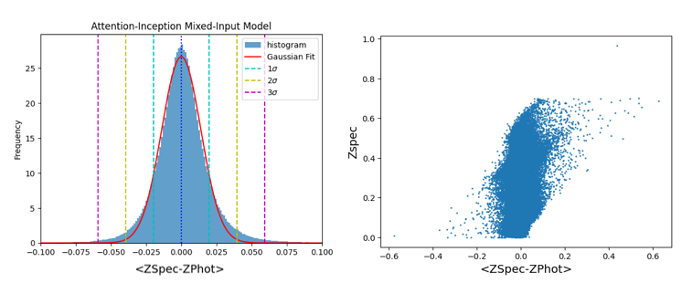
Graphical Results

Slide 16
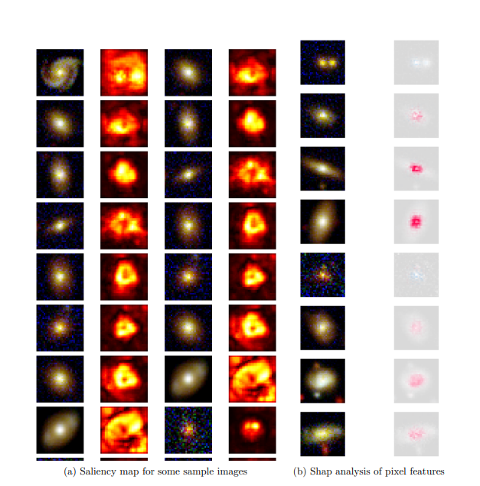
Model Explainability – Saliency Map
The area near the center is important for our model
Most of the activation is in the center of the image with a circular bright spot.
Gradient activation in saliency maps capture morphological information although it is slightly larger in area.
Future Directions !!!!
More sample objects-Better results
Exploring Upcoming Sky surveys
Investigating advanced deep framework
Better Computing Facility
Code Repo Link: https://github.com/1ArgoS1/PhotoZ/blob/main/Data_Analysis.ipynb

Slide 17
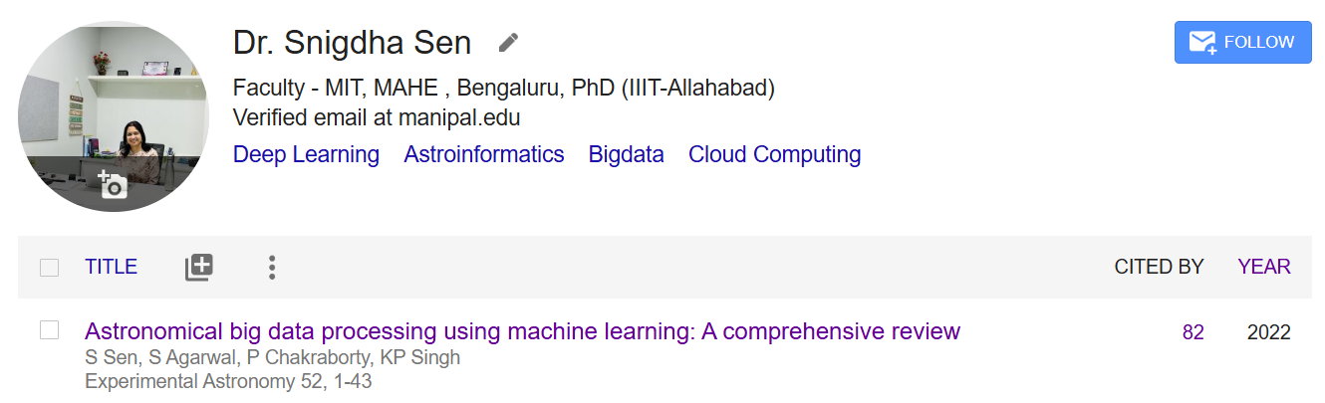
For The Beginners
Thank You

