Slide 1
NIST Data Management, Repository and AI techniques
Deoyani Nandrekar Heinis
Data Scientist
Research Data and Computing Office (RDCO)
National Institute of Standards and Technology

Slide 2
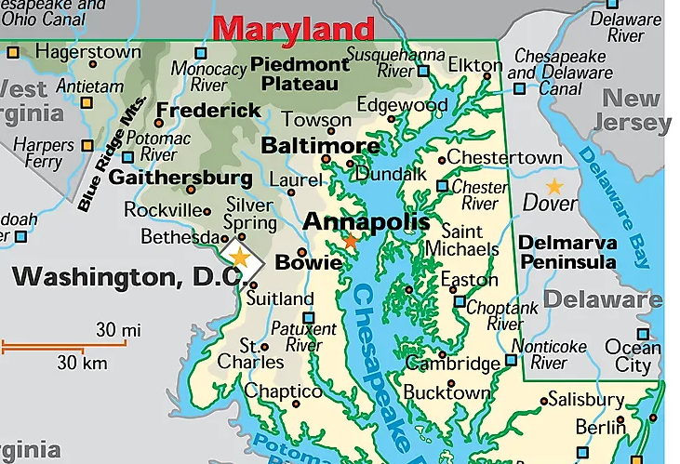
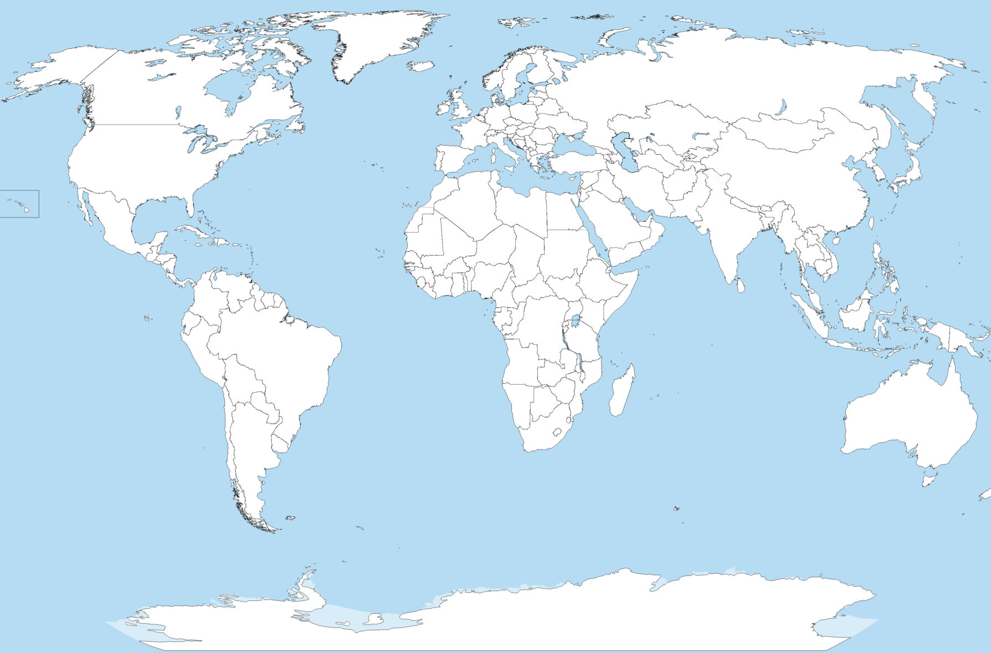


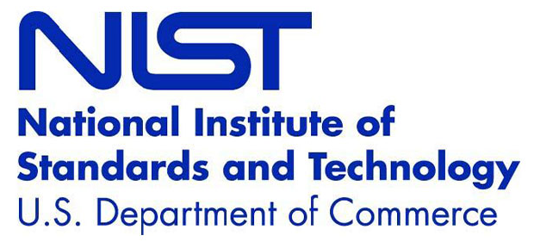
Personal and Professional background

Slide 3
NIST mission is to promote U.S. innovation and industrial competitiveness by advancing measurement science, standards, and technology in ways that enhance economic security and improve our quality of life.
measurement science
Creating the experimental and theoretical tools – methods, metrics, instruments, and data – that enable innovation
standards
Disseminating physical standards and providing technical expertise to documentary standards that enable comparison, ensure interoperability, and support commerce
technology
Driving innovation through knowledge dissemination and public-private partnerships that bridge the gap between discovery and the marketplace
‹#›

Slide 4
WHAT WE(NIST) DO ??
National Metrology Institute (NMI) for US Dept of Commerce, a government bureau since 1901
NIST is industry-focused, providing extensive ties to companies, consortia and associations
NIST is non-regulatory and doesn’t make (but can inform) policy, allowing open discussions with stakeholders – neutrality is a core concept
Multidisciplinary research
  Fundamental science with deep technical excellence
  Measurement Services: materials, data, calibration
  User facilities, investigations, consortium, Centers of Excellence, manufacturing partnerships
  Domain expertise: disaster, construction, forensics, greenhouse gas, circular economy,...
  Critical Emerging Technology (CET): Quantum, Semiconductors, Bioeconomy, AI, IoT
  Currently overseeing Chips R&D as part of the CHIPS & Science Act
Metrology = Science of measurement

Slide 5
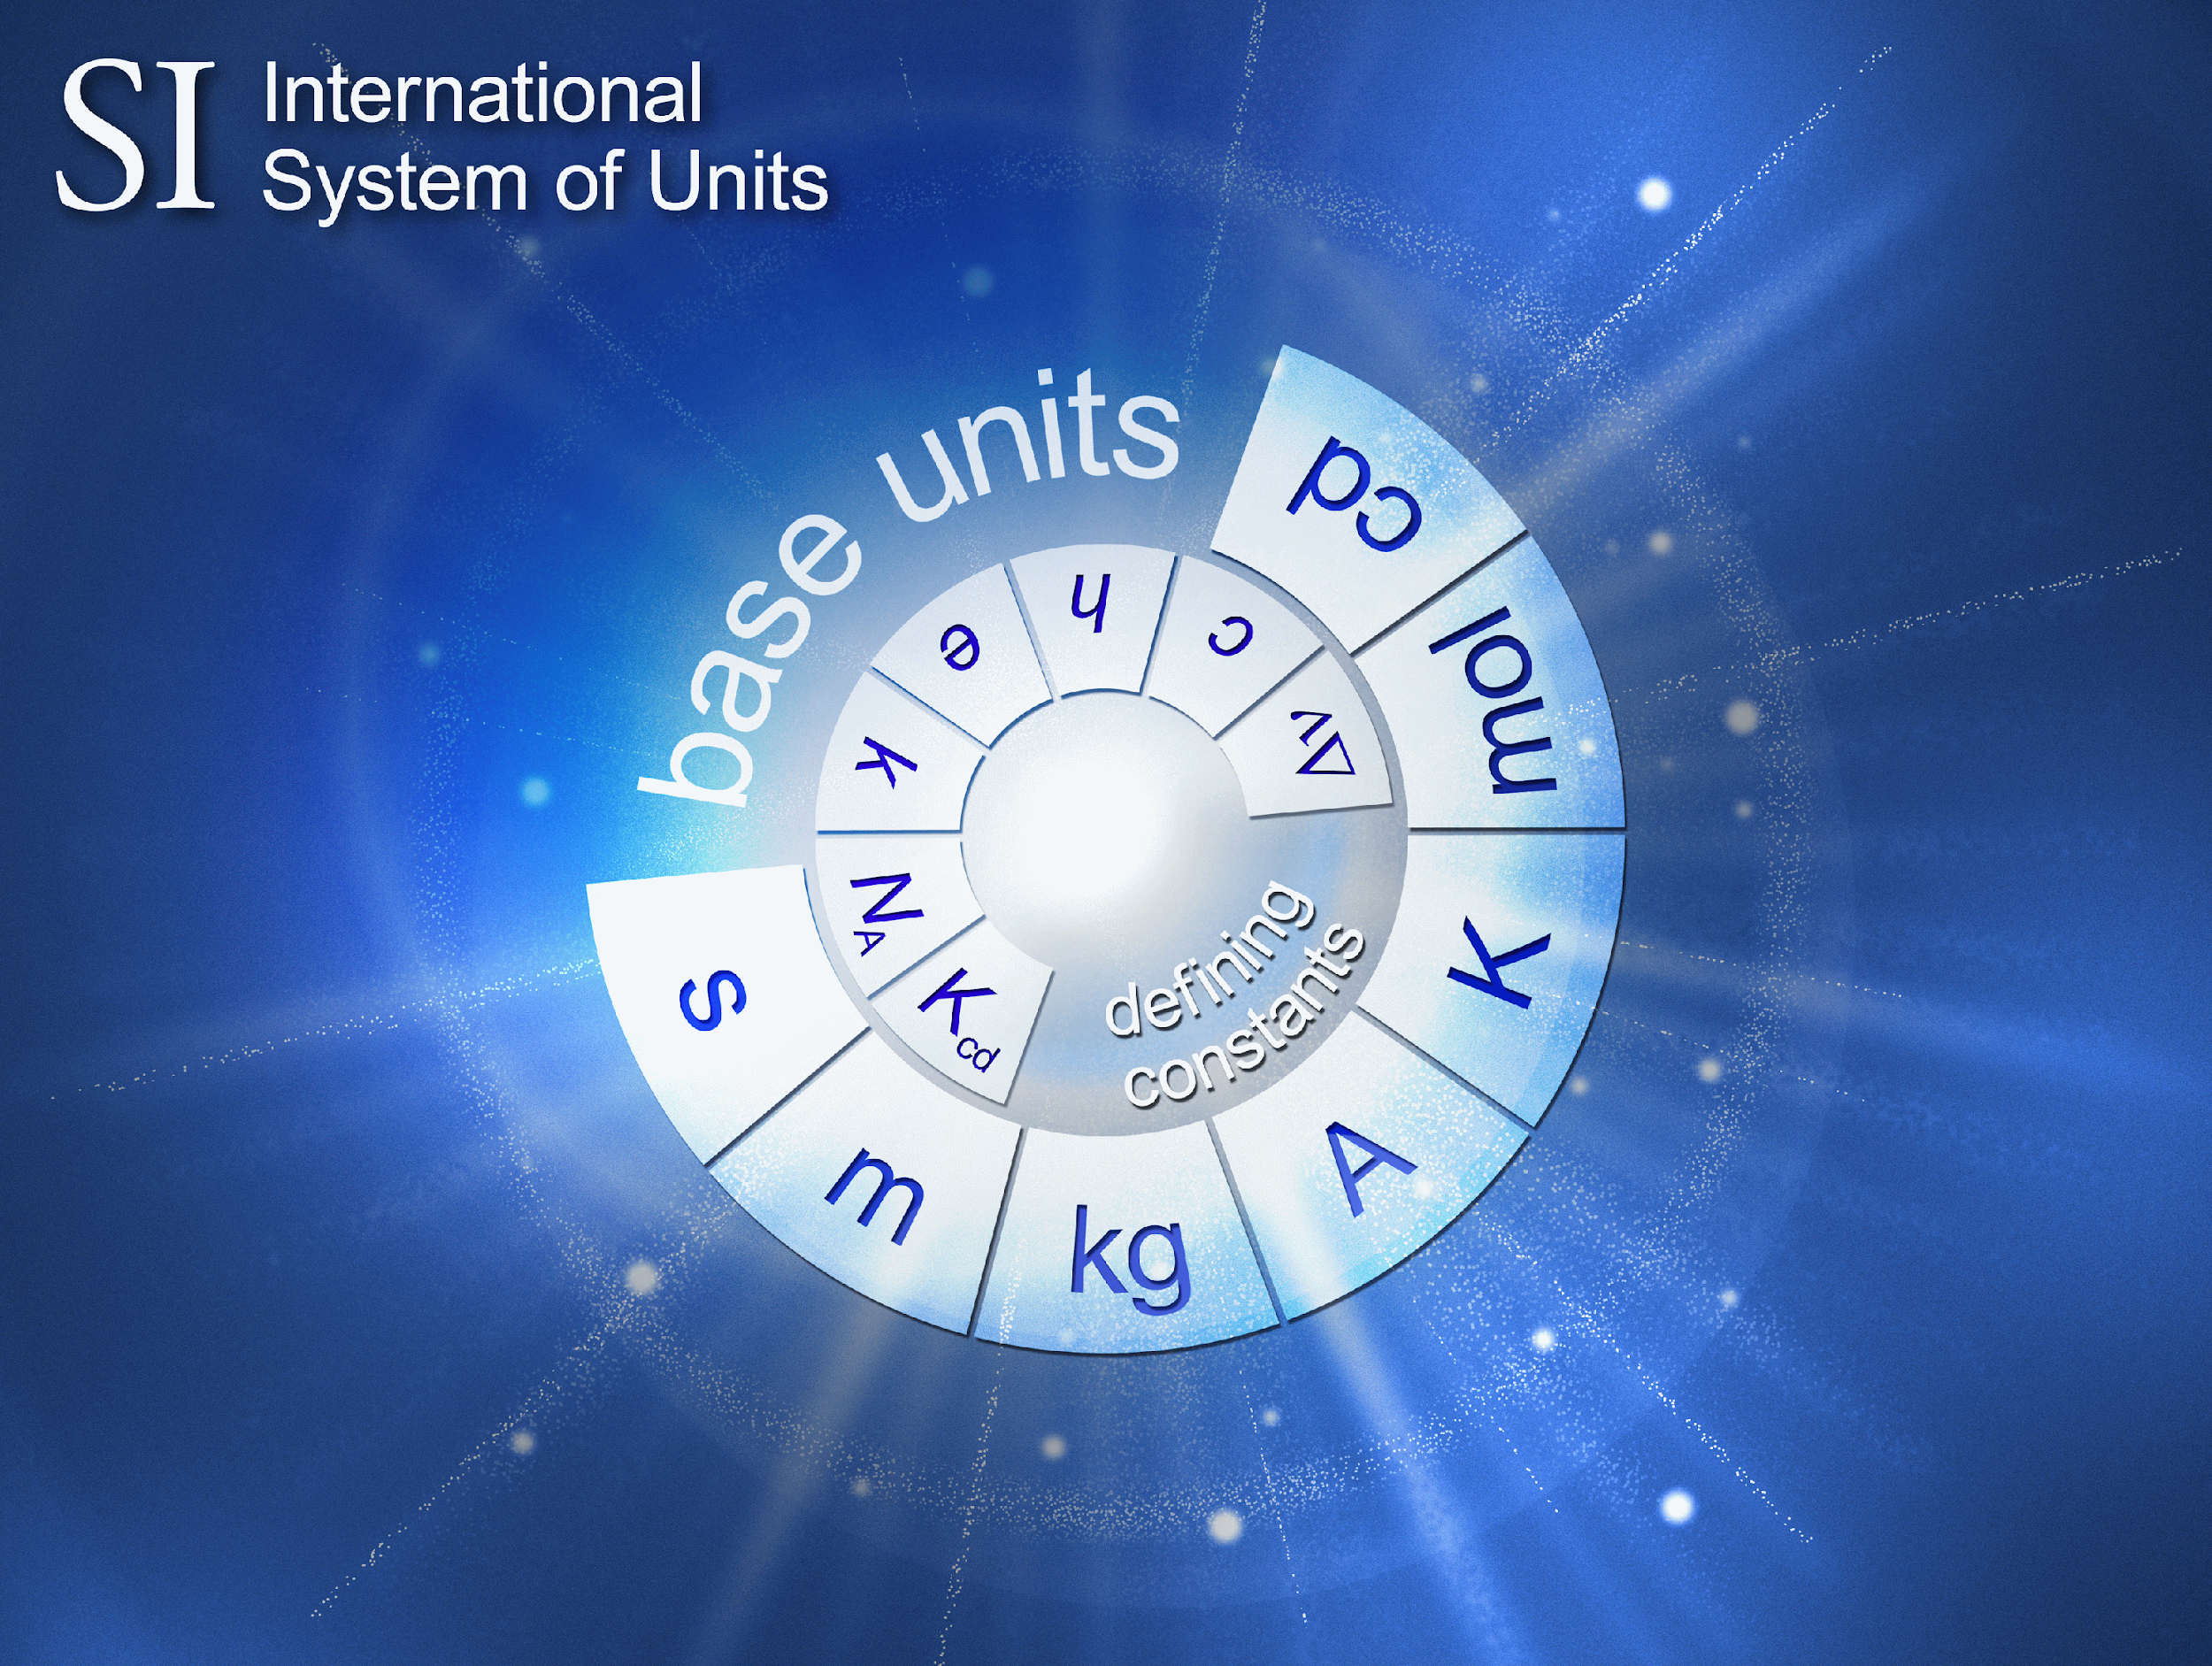

NIST defines and maintains measurements standards
The basis for trusted measurements around the globe

Slide 6
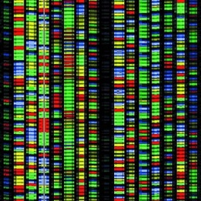
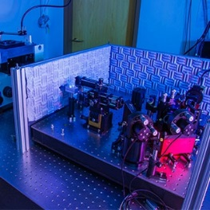
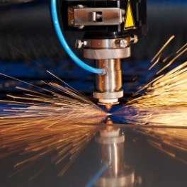

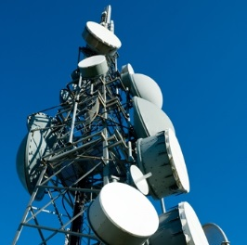
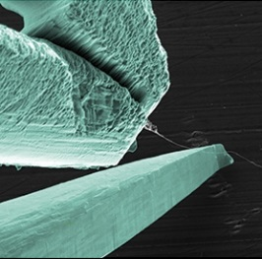
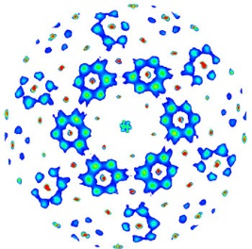
NIST Organization :: RDCO
NIST Associate Director of Laboratory Programs (ADLP) is responsible for …
Cross Laboratory Offices: Research Protections, Security, Special Programs, RDCO, Standards Coordination
Material
Measurement
Laboratory
Physical Measurement
Laboratory
Engineering Laboratory
Information Technology Laboratory
Communication
Technology Laboratory
Center for Nanoscale Science and Technology
NIST Center for Neutron Research
Metrology Laboratories
Technology Laboratories
National User Facilities
Driving innovation through
Measurement Science and Standards
Accelerating the adoption and deployment of advanced technology solutions
Providing world class, unique, and cutting-edge research facilities

Slide 7
NIST is realizing scientific data mining (aka fourth paradigm)
We are living in a time where data intensive social & physical science … engineering …technology … are intersecting and transforming our understanding
Timelines for research are shrinking from decades to days
Steep commercialization ramps related to data science
AI challenging normative practice
Complex Integrated Systems – smart, automation, …
Integrity risks and security are concerns
New science and innovations are unfolding before us
Demand exceeds our resources
NIST Research and Data Computing Office (RDCO)
Cross Laboratory governance, expertise, and project development
Open Science
Promote use of Digital Standards & Best Practices
Shared Resources & Communications
Data and Compute Intensive Science impacts our priorities and expands our societal knowledge and needs

Slide 8
Recognition early-on, data management is a key part of scientific productivity however, the scientific use cases should drive the data system design in concert with the primary goal
“e.g., to allow modelers to test their simulations against rigorous, highly controlled additive manufacturing benchmark test data”. [e.g. “the SZALAY 10 questions approach”]
Required Core Capabilities
  Data file storage –Public repos, Private repos, Specified release dates, Backups, Archiving (manyBs of data!)
  Data/Metadata transfers – Between Groups, Divisions, Laboratories, Campuses, Outside collaborators
  Data access requirements of different collaborators (e.g., universities, DoE labs, etc.)
  User data activities – Searches, Downloads, Visualization, Analysis
  Community support and growth – Software sharing, Outside data inputs/vetting
  Metadata capture – Many different measurements and data sources
  Metadata storage and sharing – repository solution, architecture, semantics
  Security Controls – increasingly complex and challenging technology integration
NIST will Enable Digital Metrology through Provenance, Traceability, Verification and Validation
In the context of the FAIR research data principles:
Findable ♦ Accessible ♦ Interoperable ♦ Reusable

Slide 9
RDCO maintains its own research computing facilities
Traditional HPC system – “Blackbird”:​
15,288 processor cores and 70 TB of RAM spread across 91 “nodes” with a 400 Gb/s interconnect​
200 TB Cluster local storage at 400 Gb/s​
AI/ML System (GPU) – “Redwing”​
32 state-of-the-art GPUs, and 288 processor cores, 8TB of RAM across 4 “nodes” with 400 Gb/s interconnect​
100 TB Cluster local storage at 400 Gb/s
Provide shared computational tools — let researchers focus on the research!​
Enable access to HPC for users at all levels of expertise ​(Upskill and support the NIST research community)​
Build community – retain and share solutions​
Enable incoming researchers to be able to hit the ground running! ​
Increase NIST productivity toward core mission​

Slide 10





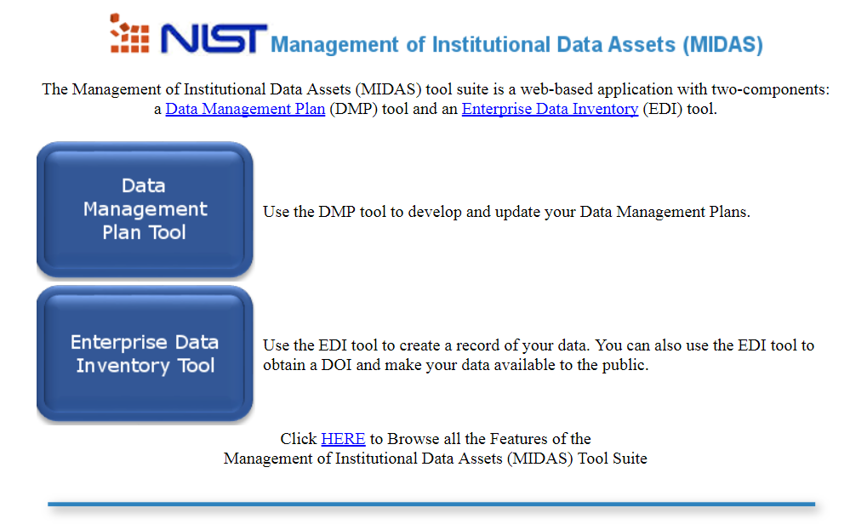
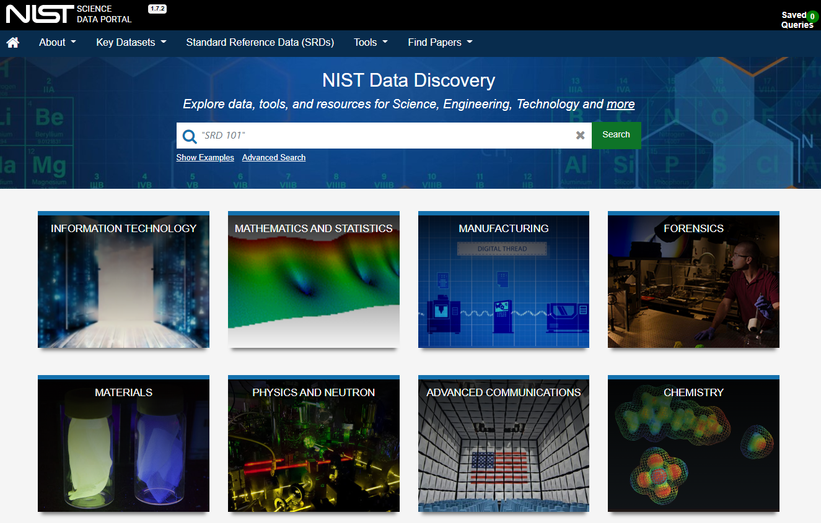






RDCO is in charge of maintaining data repositories for open science usage
Research Data Community
NIST Researchers
Public Data Inventory
Search
Access
MIDAS – NIST Internal Workflows
Public Access Systems
Science Data Portal & Public Data Repository
Laboratory Information Management Systems (LIMS)
Domain Metadata
Submit Data
NPS Data Review
Preserve
Publish
Citation
Research Collaboration Tools
Quality Control
Usage Metrics
Code/SW Repository
Access Control
File Management
User Support
Integrity
Checking
Persistent identifiers (data DOIs, author IDs)
Safe Store

Slide 11
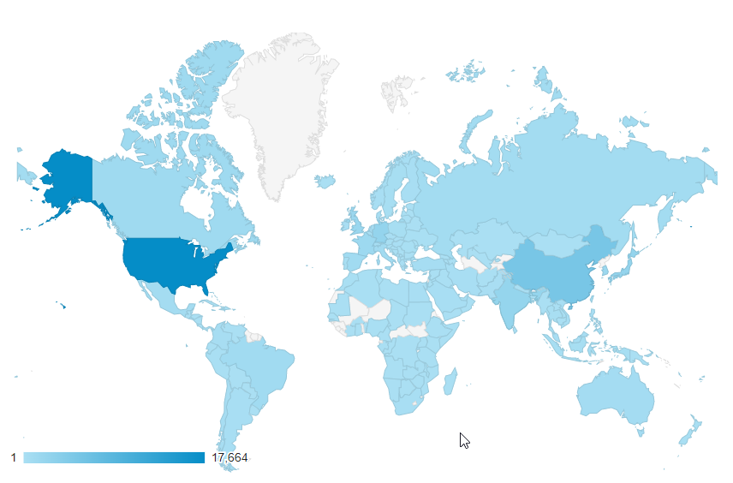
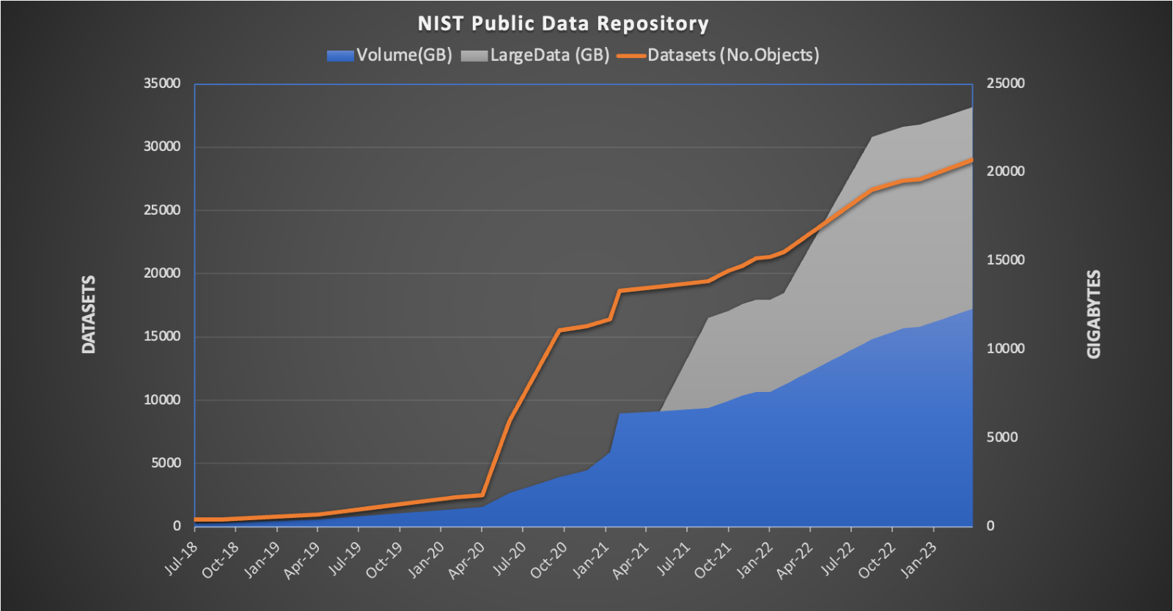
RDCO open data reaches worldwide
Sharp increase in data usage during pandemic
Annual reach 173 countries ~5000 users monthly
~200TB Annual Download
Home to more than 1000 domain based data publications

Slide 12
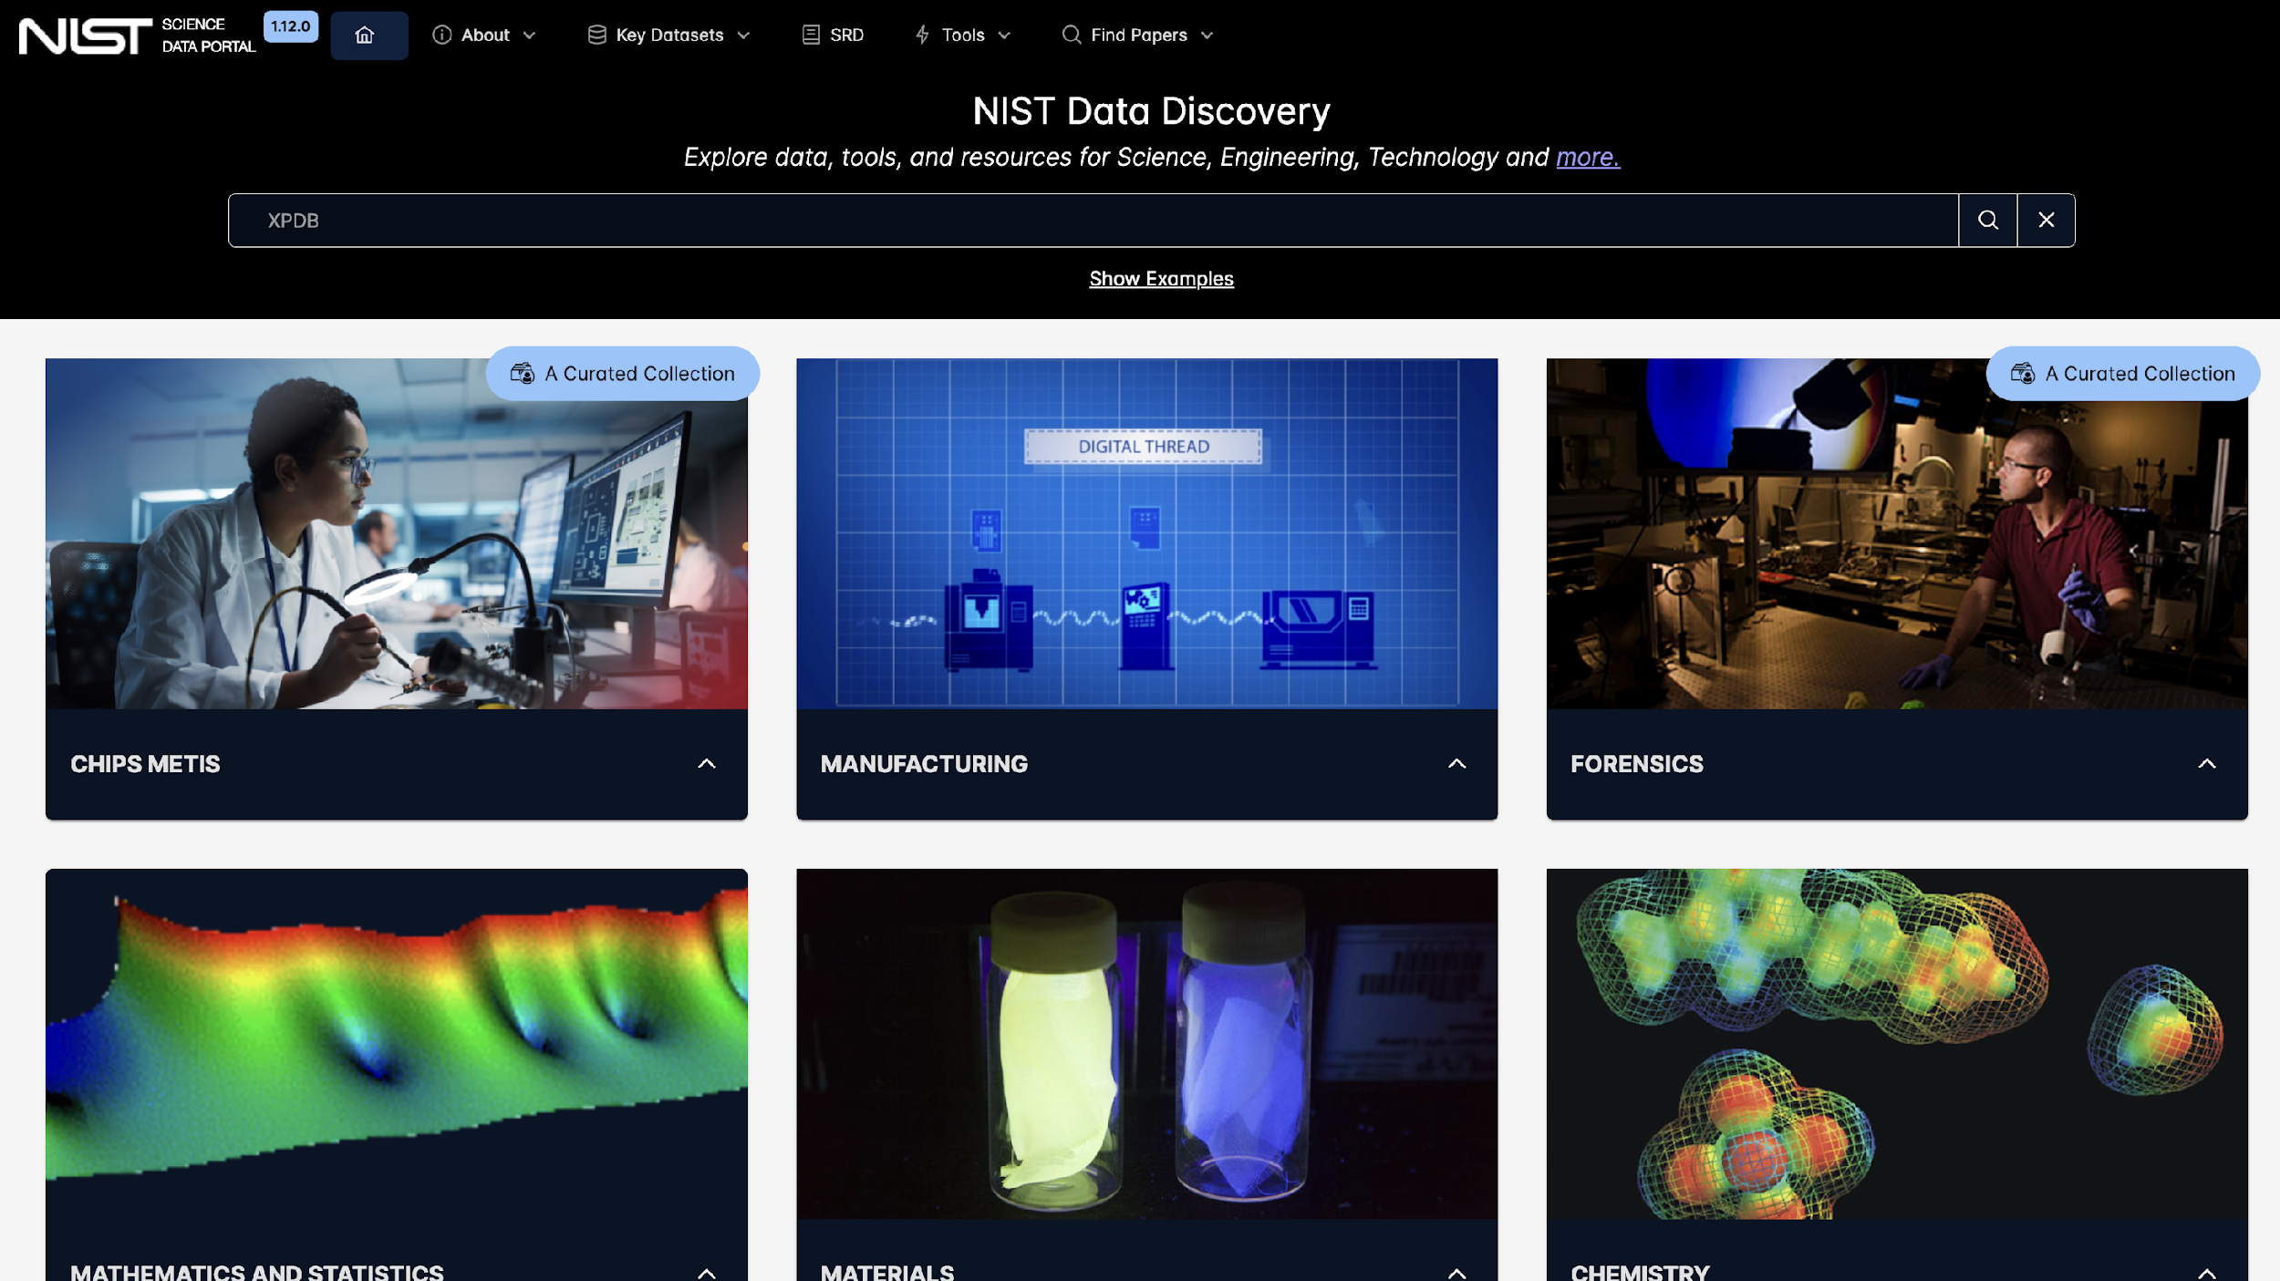
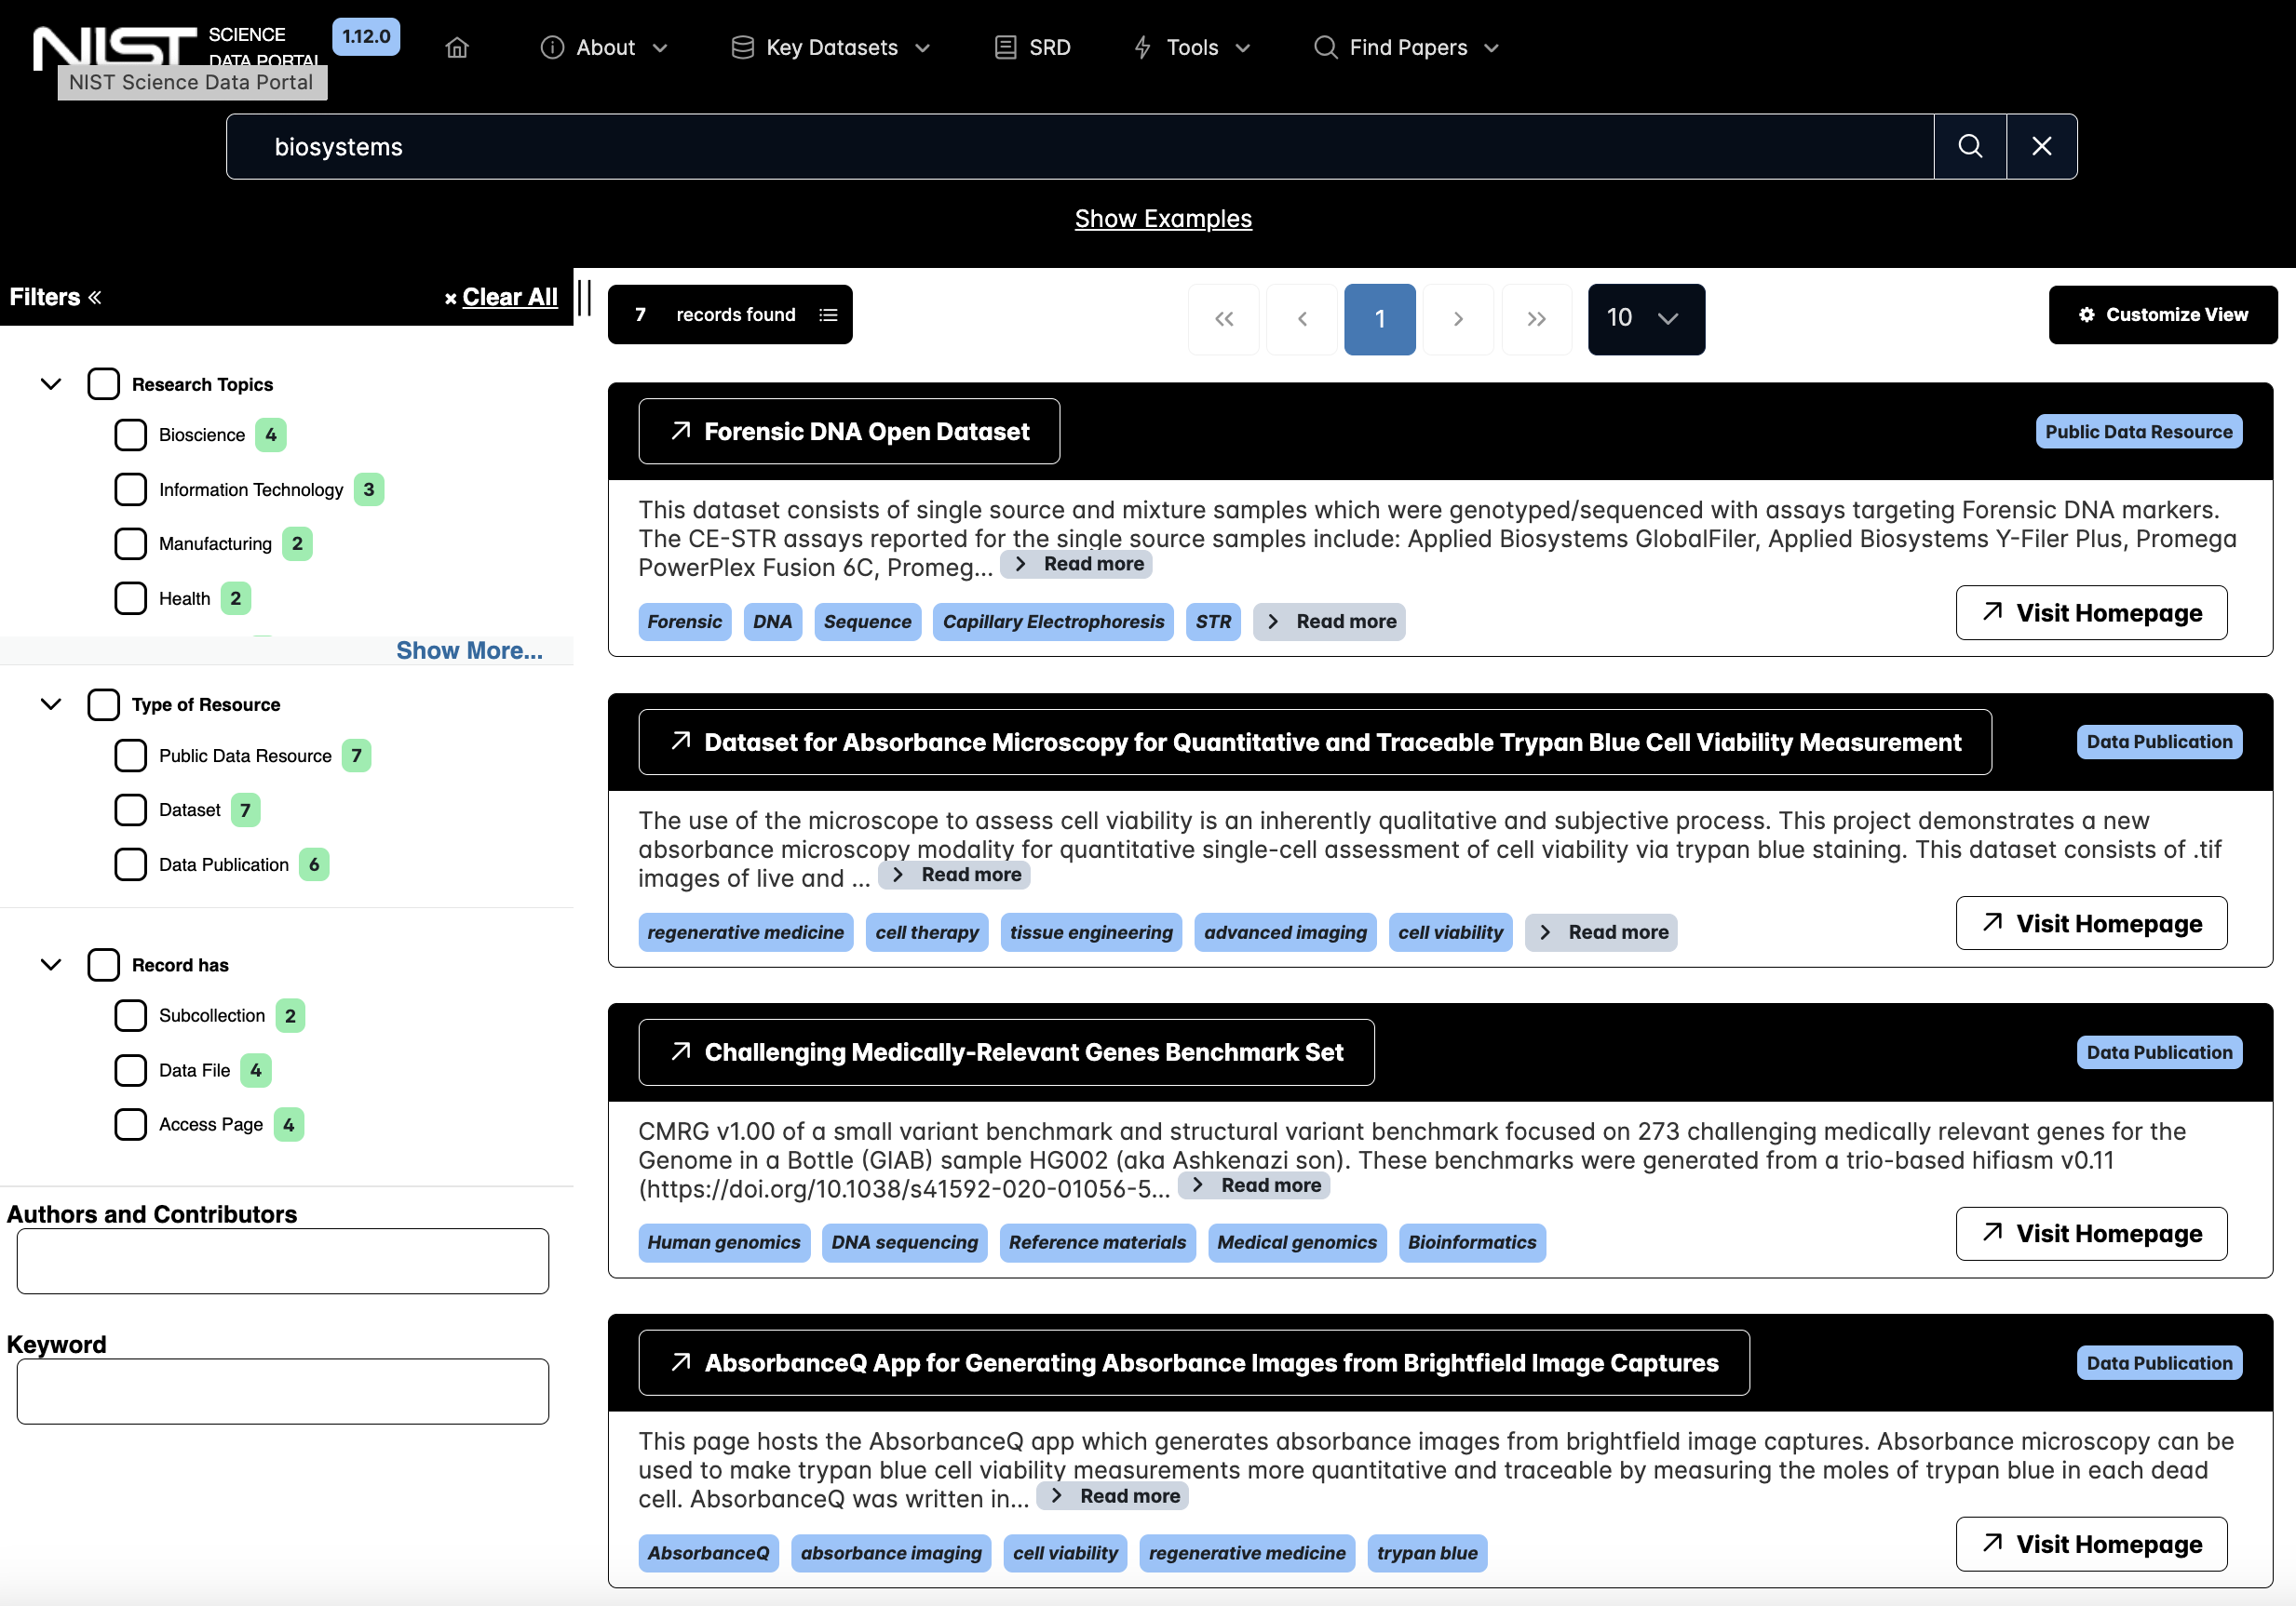
F-A-I-R Data System is based on machine actionable content, and
underlying Linked-Data Semantics

Slide 13
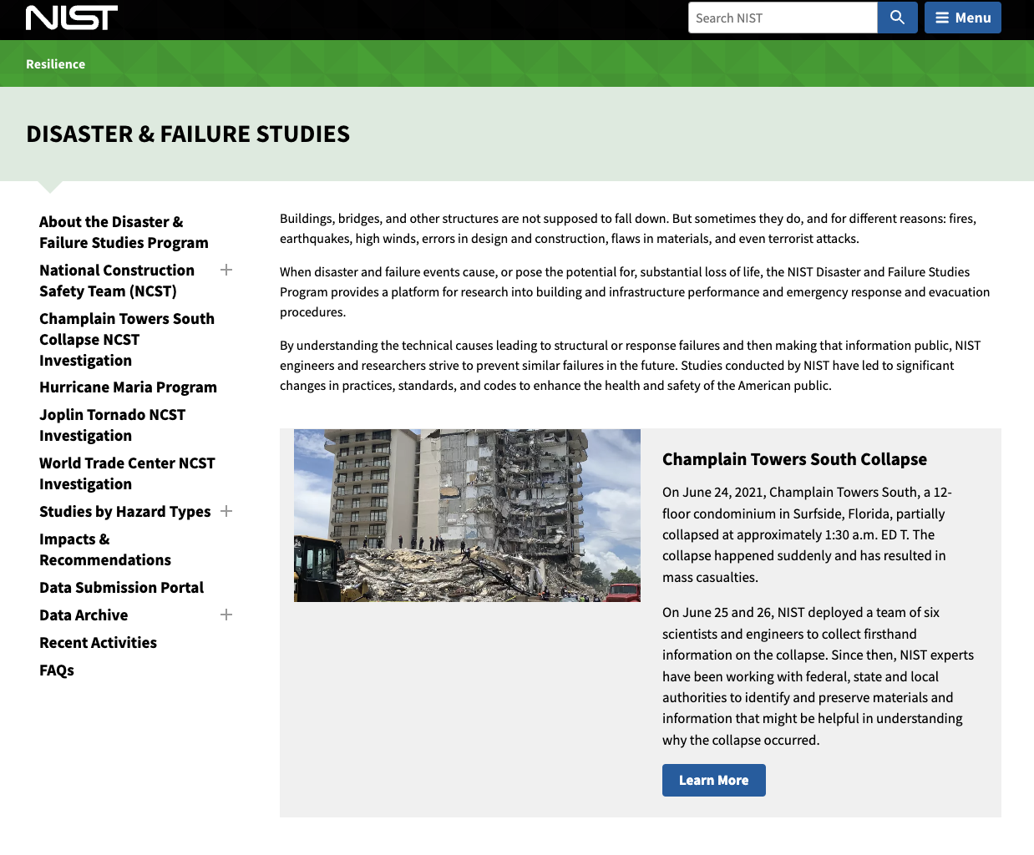
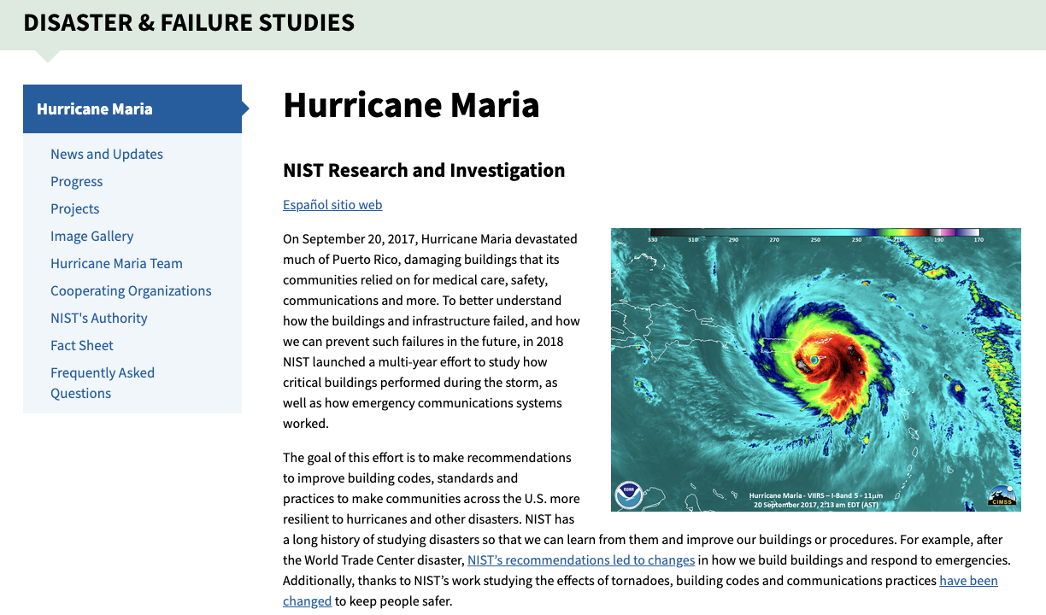
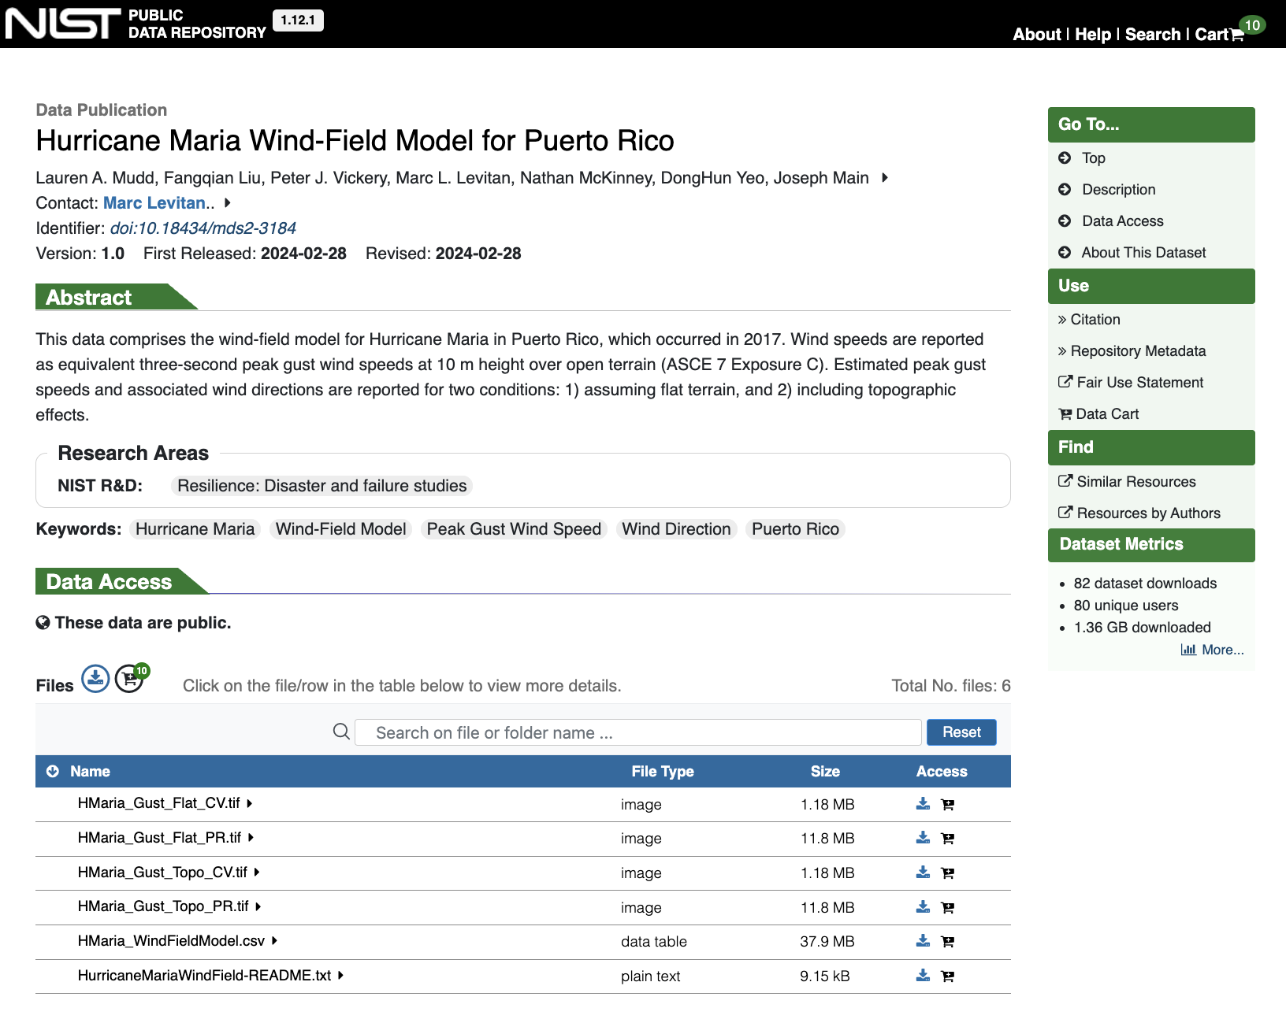
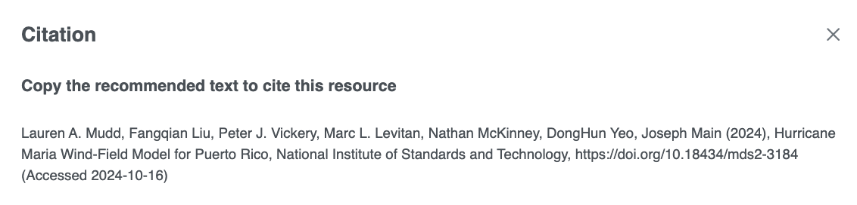
Data Publication & Access
The wind-field model dataset used to create this wind speed map is available here: https://doi.org/10.18434/mds2-3184

Slide 14
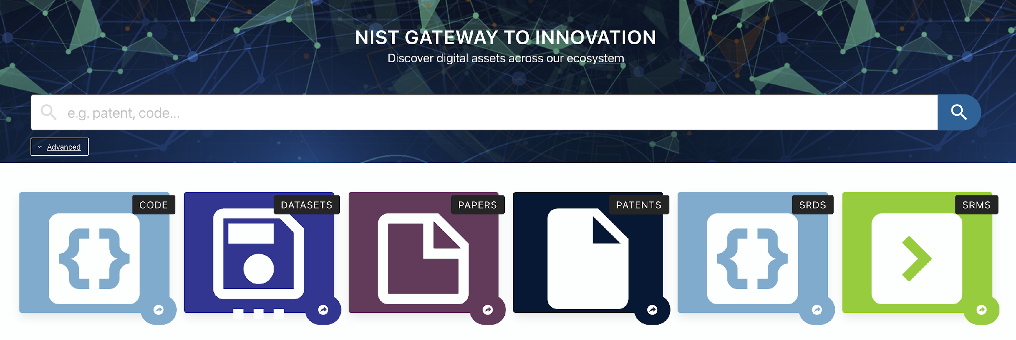
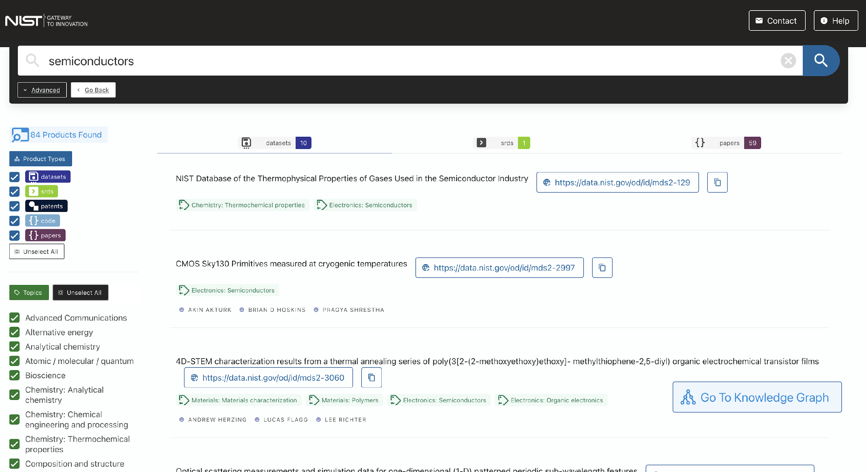
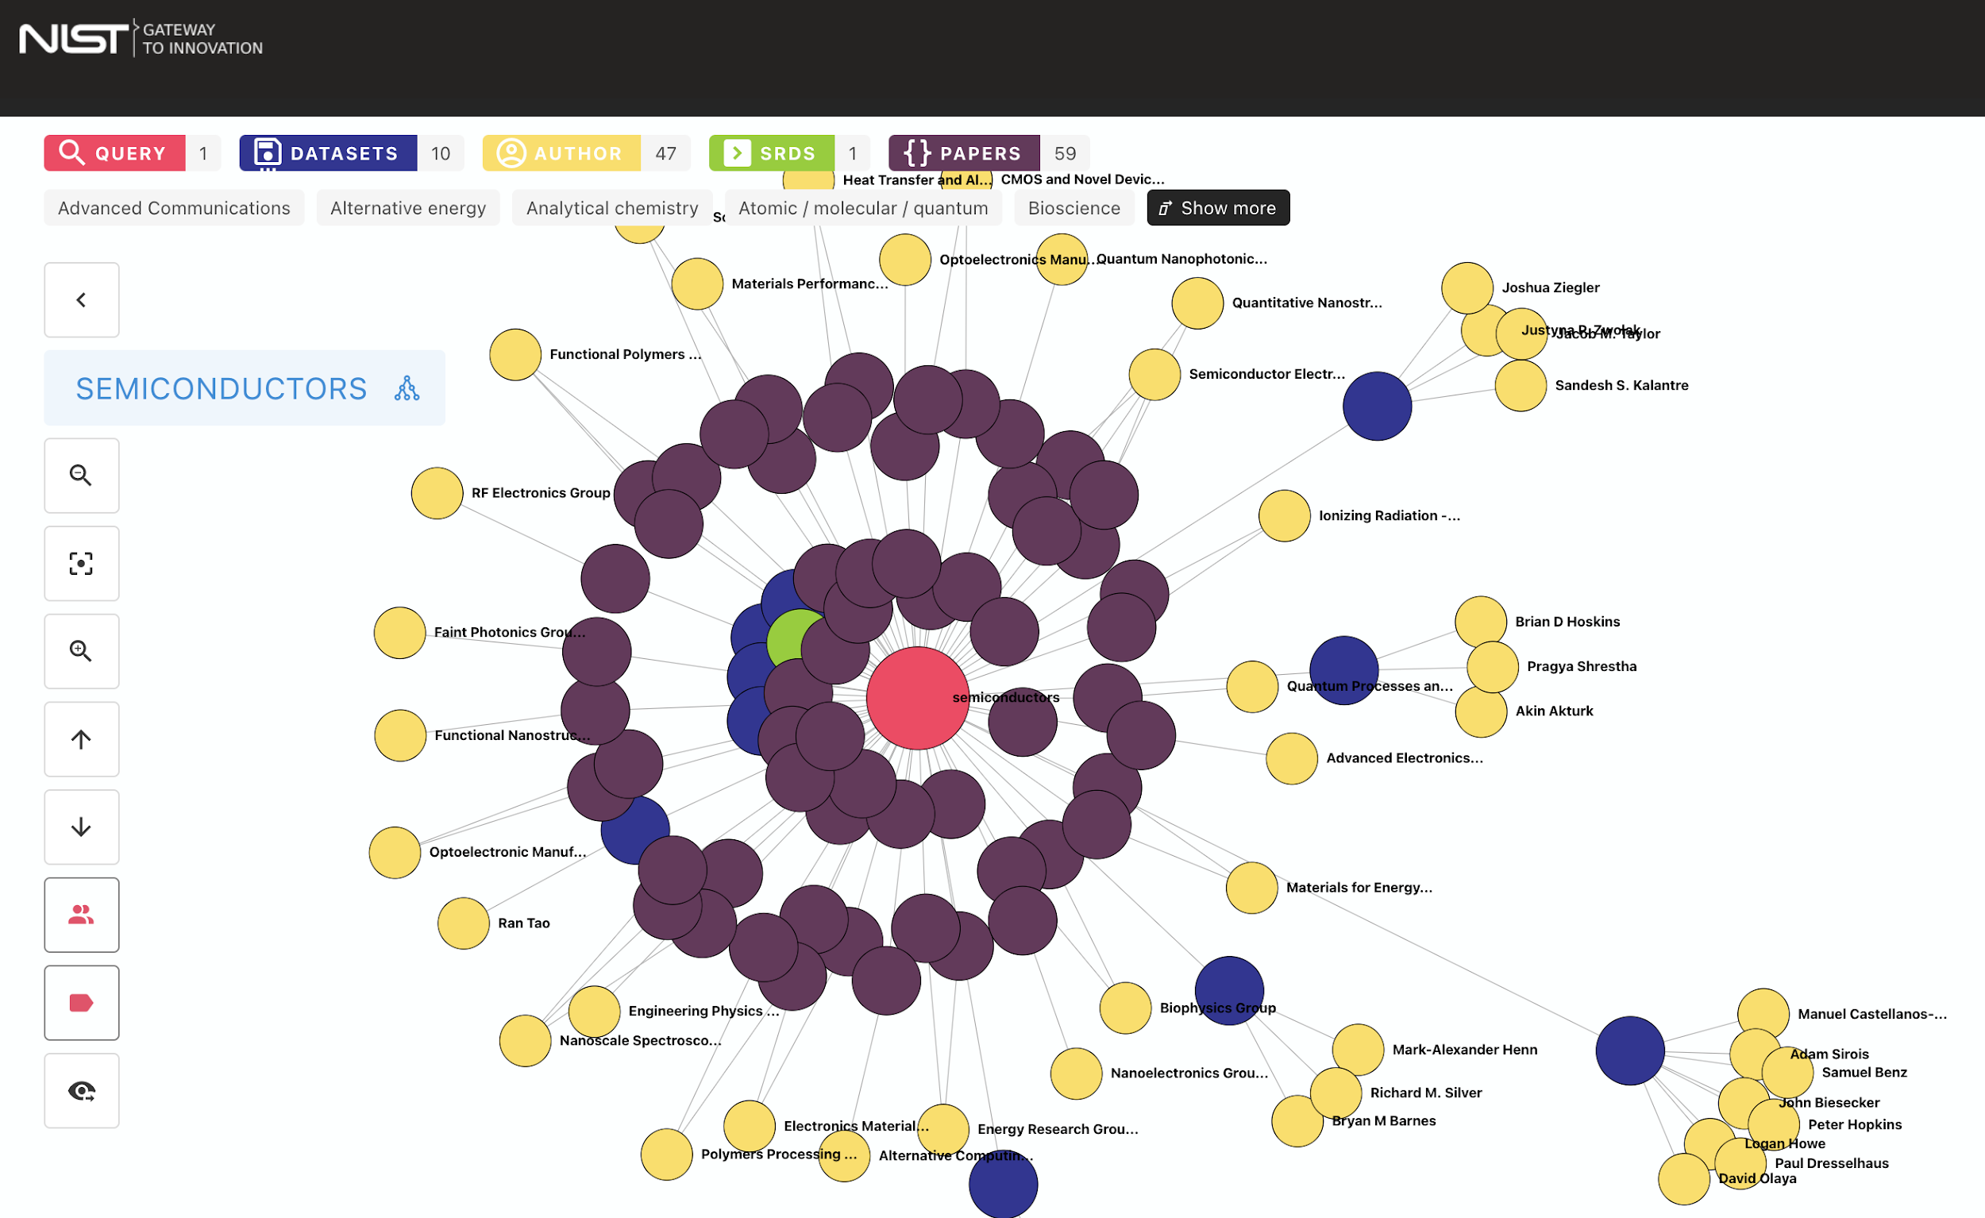
Data Repo :: NIST Gateway to Innovation

Slide 15
NIST is at the forefront of responsible and applied AI
Responsible AI
Applied AI Areas
Develop and maintain guidance to help improve the safety, security and trustworthiness of artificial intelligence (AI) systems
Explore AI capabilities and limitations for their research
AI’s full commercial and societal benefits can be realized without harm to people or the planet
Computer Vision
Bio-engineering
Material science
Manufacturing
Disaster study

Slide 16
AI @ NIST: Example #1
The Additive Manufacturing Benchmark Series (AM Bench)
What is AM Bench?
A continuing series of highly controlled benchmark measurements for additive manufacturing, with modeling challenge problems and a corresponding conference series
Mechanistic
models
Thermokinetic models
Reduced order
and surrogate
models
Primary Goal
To allow modelers to test their simulations
against rigorous, highly controlled additive
manufacturing benchmark test data
Data driven (AI/ML) models

Slide 17
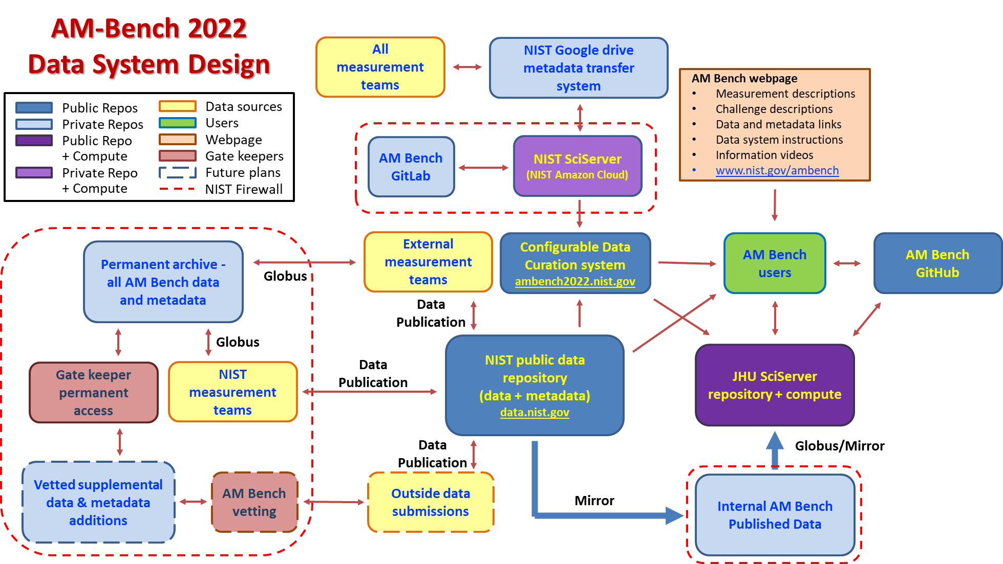
AI @ NIST: Example #1

Slide 18
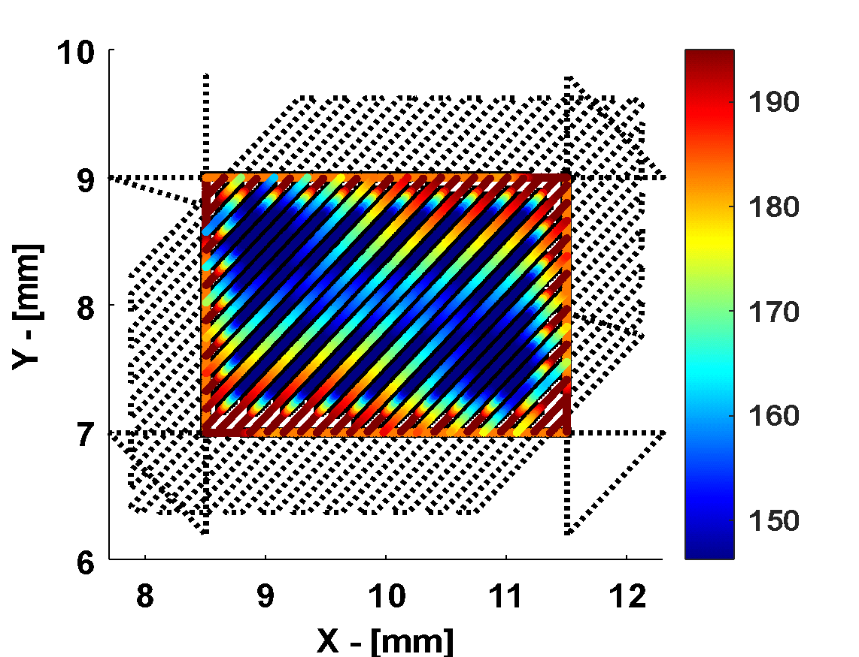
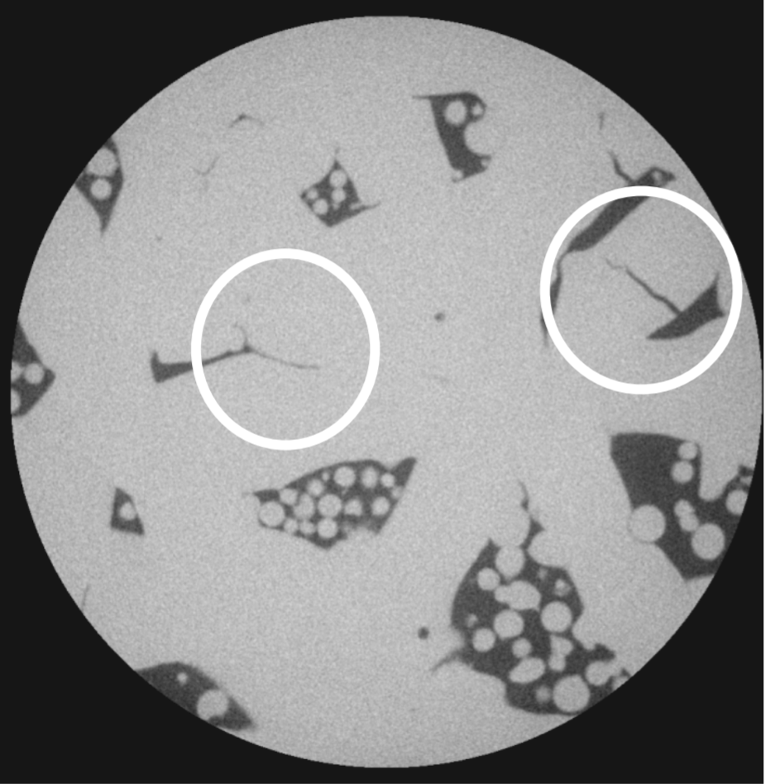
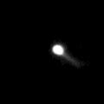
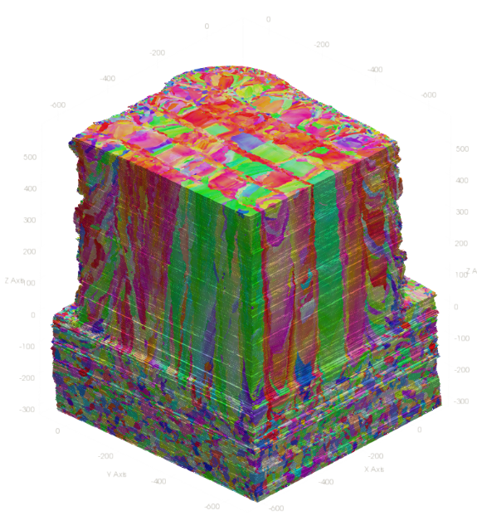
AI @ NIST: Example #1
Extracting meaningful data from large data sets :: challenging
Processing Inputs (4D)
P( x(t), y(t) )
3D defect structure
Time & position registration
Multimodal digital twin
Many data sets > 1 TB
Server-side analysis with pre-written codes needed
User-developed codes could be shared
In situ 4D thermal imaging
Not AM Bench material!
3D microstructure
We have adopted SciServer
for server-side analysis

Slide 19
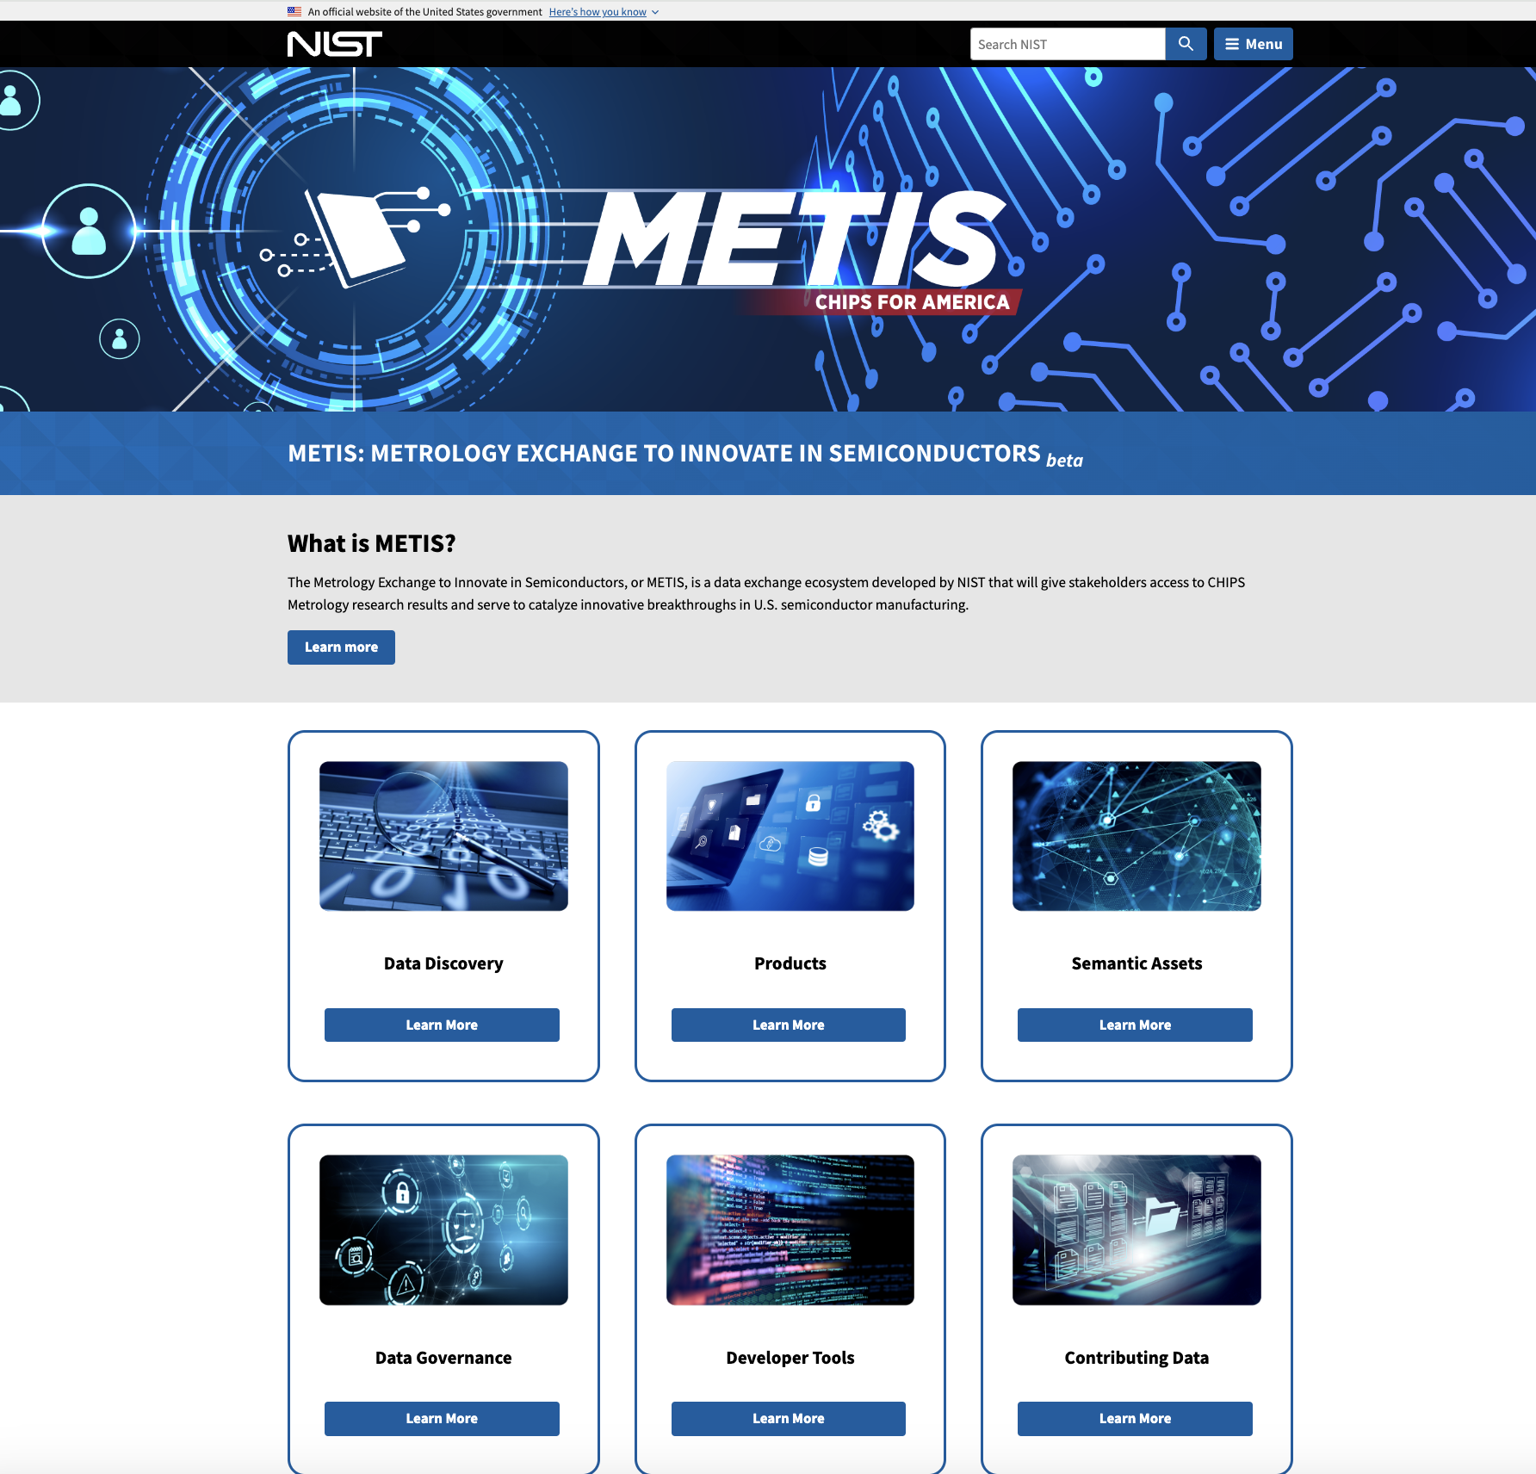
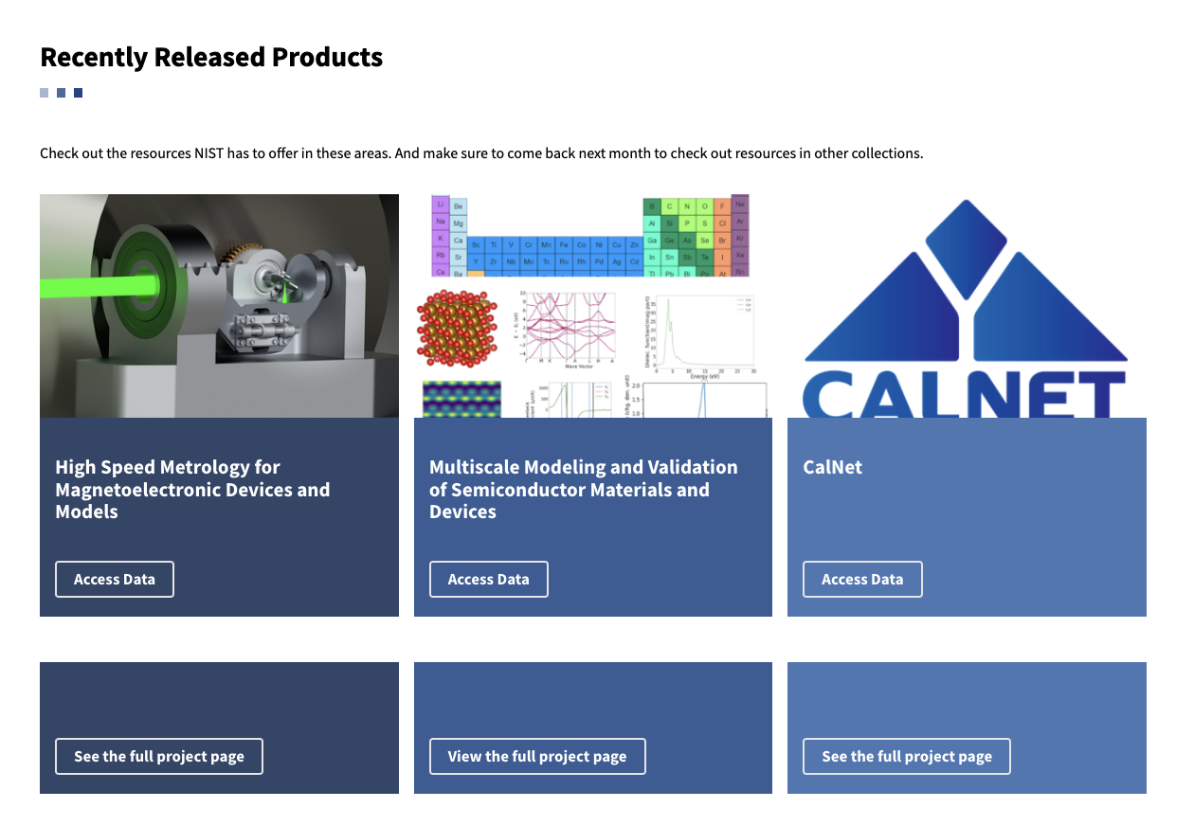
AI @ NIST: Example #2
NIST is leading the programs to strengthen and revitalize the U.S. position in semiconductor research, development, and manufacturing
METIS beta Launch
https://metis.nist.gov

Slide 20
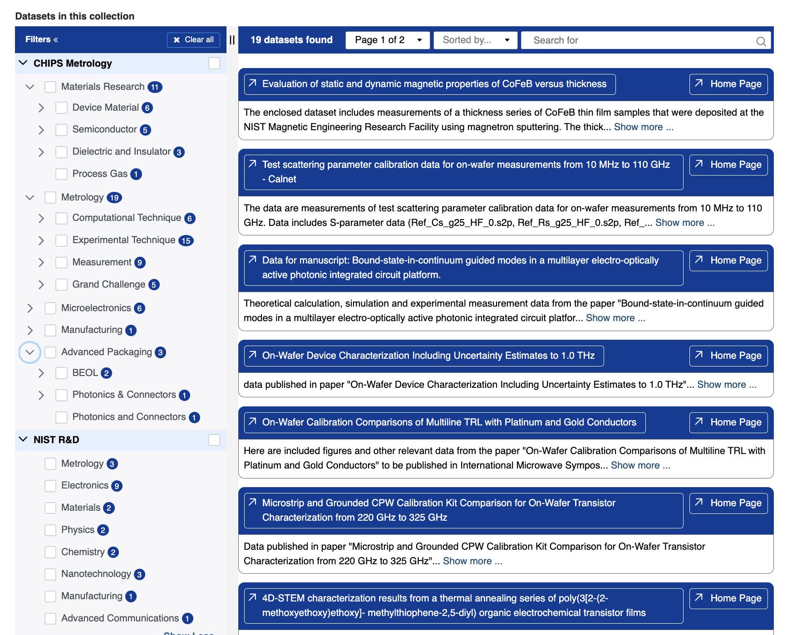
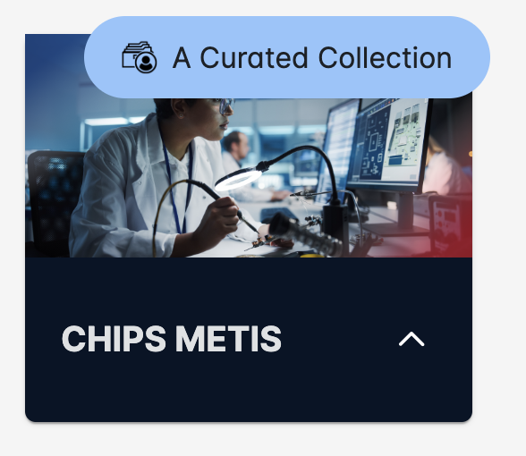
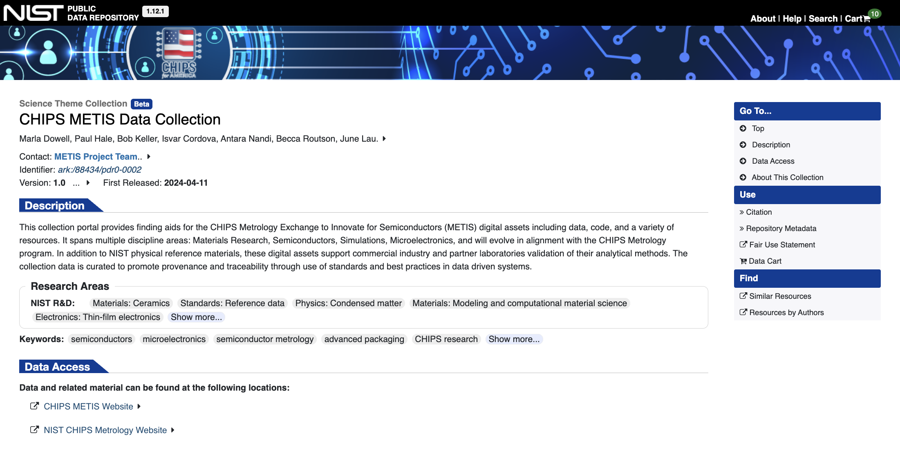
AI @ NIST: Example #2
DOMAIN TAXONOMY
AI Generated terms for taxonomy?

Slide 21














AI @ NIST: Example #3
Electron Microscopy Laboratory Science infrastructure is designed to be AI enabled
Data Lake / Storage
(TB/PB Files)
AI/Machine Learning
(HPC, Pipelines, Analytics)
Research Data Management Ecosystem
Electronic Lab Notebooks
Measurement Repository
Instrument Database
Community Knowledge Network
Experimental Scheduling

Slide 22
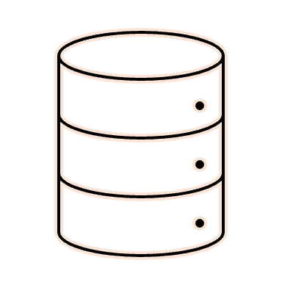

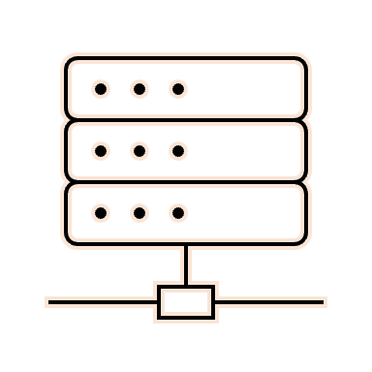



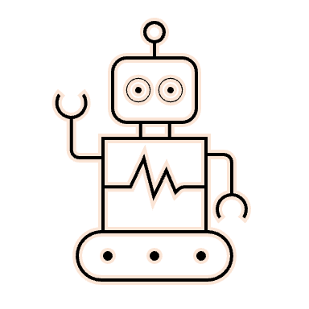



AI @ NIST: Example #4
Data/Metadata Stores
Doing Science
NIST is collaborating with other agencies to test implementations of AI Research Assistants
Protocol
HPC/Cloud
Code Repos
Lab Equipment
NIST Data Science Collaboration with National Renewal Energy Lab (NREL)
Where to place turbine? How to integrate into grid?
Domain Science
Atmospheric Models
Slide Ref: Sagi Zisman, NREL

Slide 23

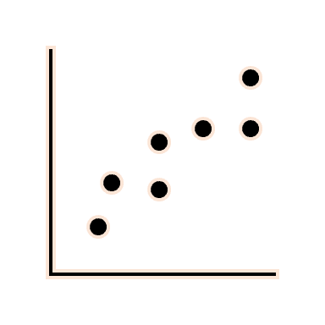

AI @ NIST: Example #4
Doing Science
Data/Metadata Stores
Proposed Solution
Protocol
HPC/Cloud
Code Repos
Lab Equipment
APIs to everything!
Security Aware
LLM
Reasoner/RAG/CRAG
(LLM + GNNs + Symbolic)
Domain Artifact

Slide 24
NIST is involved in a number of other AI Applied Research Projects
Subspace-informed Deep Learning Solutions for Nanoscale Microscopy
NIST is developing AI and machine learning methods to improve the fidelity of novel nanoscale microscopy techniques that are under research by NIST physicists.
2. AI-based Measurements For Imaging
NIST streamlines deriving measurements from terabyte-sized images and improves image-based measurement accuracy via web-based applications addressing image analyses and AI-based modeling.
3. Imaging & Artificial Intelligence (AI) to Assess Tissue Quality (in collaboration with NIH)
To develop an approach for non-invasively assessing quality of clinical-grade tissue-engineered human retinal pigment epithelium (RPE). The method uses quantitative brightfield absorbance imaging (QBAM) and AI

Slide 25
We clearly are past the tipping point for data driven science, “We need the way of thinking we have in physics to study machine learning”
Data intensive systems engineering and machine learning go hand in hand
  For example, the Protein Data Bank = transferring intuitions from years of expertise into machine learning
  Nature News Article By Davide Castelvecchi, Ewen Callaway & Diana Kwon “AI comes to the Nobels: double win sparks debate about scientific fields”
Information exchange in distributed architectures – trusted protocols
Characterization of ML/DL at larger scale & complexity
Semantic development – data driven ontology
  Synthesis across algorithmic, human and data science experts
Embrace what the re-imagined Data Intensive science has to offer our community
Cross cutting science, big problem science
Dynamic data modeling and structuring vs. decades of debate
Standards and pattern determinism – OOMs reduced timescales

Slide 26
Parallels with Astronomy?

Slide 27
Thank You!
Contact: deoyani.nandrekarheinis@nist.gov

Slide 29





Data Infrastructure - Informatics
Knowledge Infrastructure
Lab-of-the-future applications
Can Extend Across Org Boundaries
Data Infrastructure
Data Mesh
Recommendations
Domain Experts/Ontologists
Distributed Data Storage
Wind Data Products
Knowledge Graph
Solar Data Products
Automated Laboratories
Distributed Data Storage
Knowledge Dissemination
Distributed Data Storage
Material Science Data Products
Knowledge Discovery

Slide 30
So where do we go from here?
We clearly are past the tipping point for data driven science, “We need the way of thinking we have in physics to study machine learning”
Data intensive systems engineering and machine learning go hand in hand
  For example, the Protein Data Bank = transferring intuitions from years of expertise into machine learning
  Nature News Article By Davide Castelvecchi, Ewen Callaway & Diana Kwon “AI comes to the Nobels: double win sparks debate about scientific fields”
Information exchange in distributed architectures – trusted protocols
Characterization of ML/DL at larger scale & complexity
Semantic development – data driven ontology
  Synthesis across algorithmic, human and data science experts
Embrace what the re-imagined Data Intensive science has to offer our community
Cross cutting science, big problem science
Dynamic data modeling and structuring vs. decades of debate
Standards and pattern determinism – OOMs reduced timescales

Slide 31
Thank You!

