Slide 1

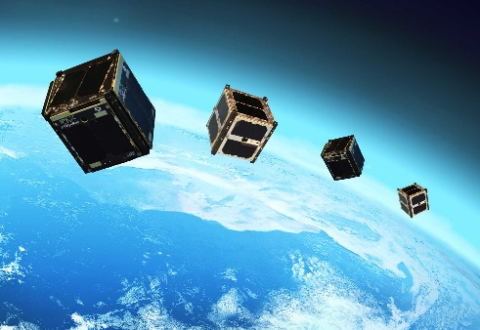
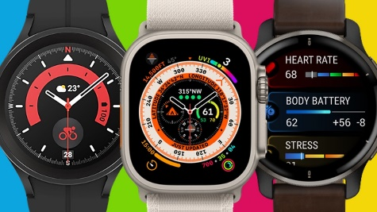
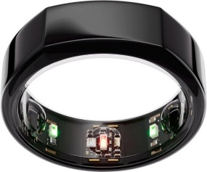
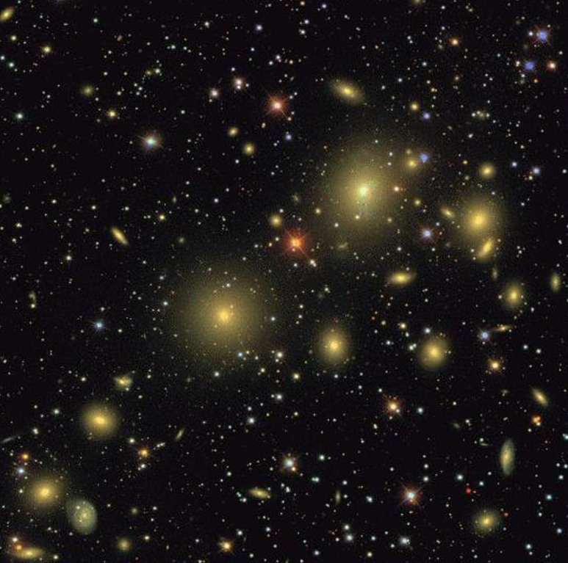
AI-ready Data in Astrophysics: from Sensors to Tensors
Alex Szalay
The Johns Hopkins University

Slide 2

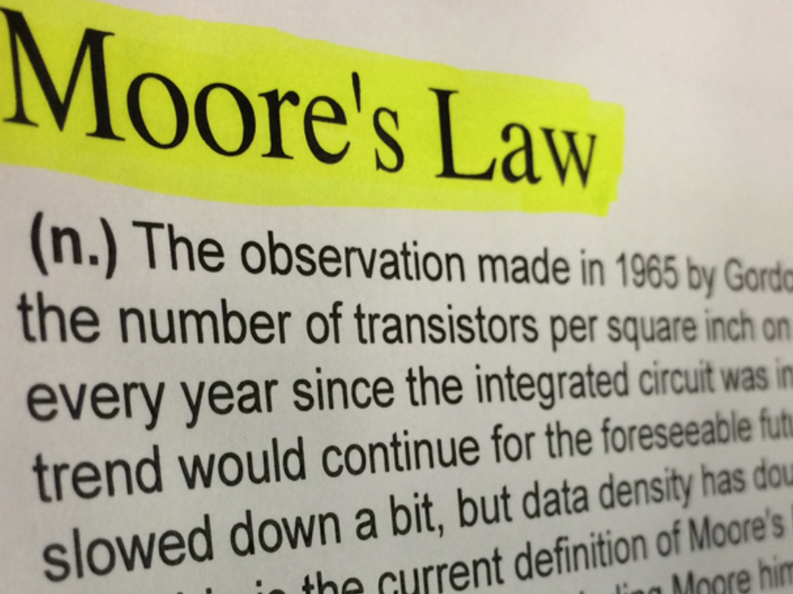
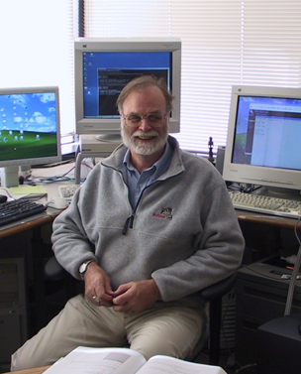
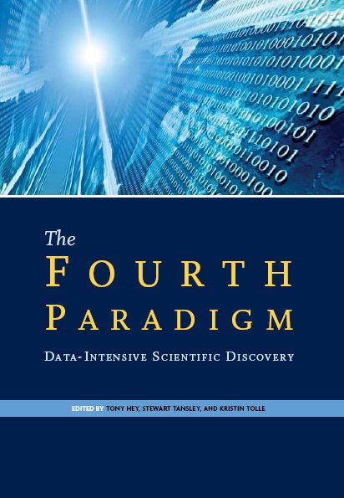
Introduction
Open Data has brought a new revolution in science, transforming everything
=> Open Science
Enabled by the exponential growth in our computational technologies
The Fourth Paradigm of Science emerged, driven by Data
Jim Gray

Slide 3
AI is a New Kind of Revolution
Until now most of computing was deterministic
Neural network weights start from random initial condition
After training they yield similar (but not identical) inferences
Everything moves from deterministic to probabilistic and stochastic
A similar major shift happened in the past 100 years ago:
Deterministic Classical Physics vs Probabilistic Quantum Mechanics
QM split the physics community:
It was embraced by the 20-year olds, while the elder were scratching their heads
QM changed not just physics but our lives
AI is the new Quantum Mechanics

Slide 4
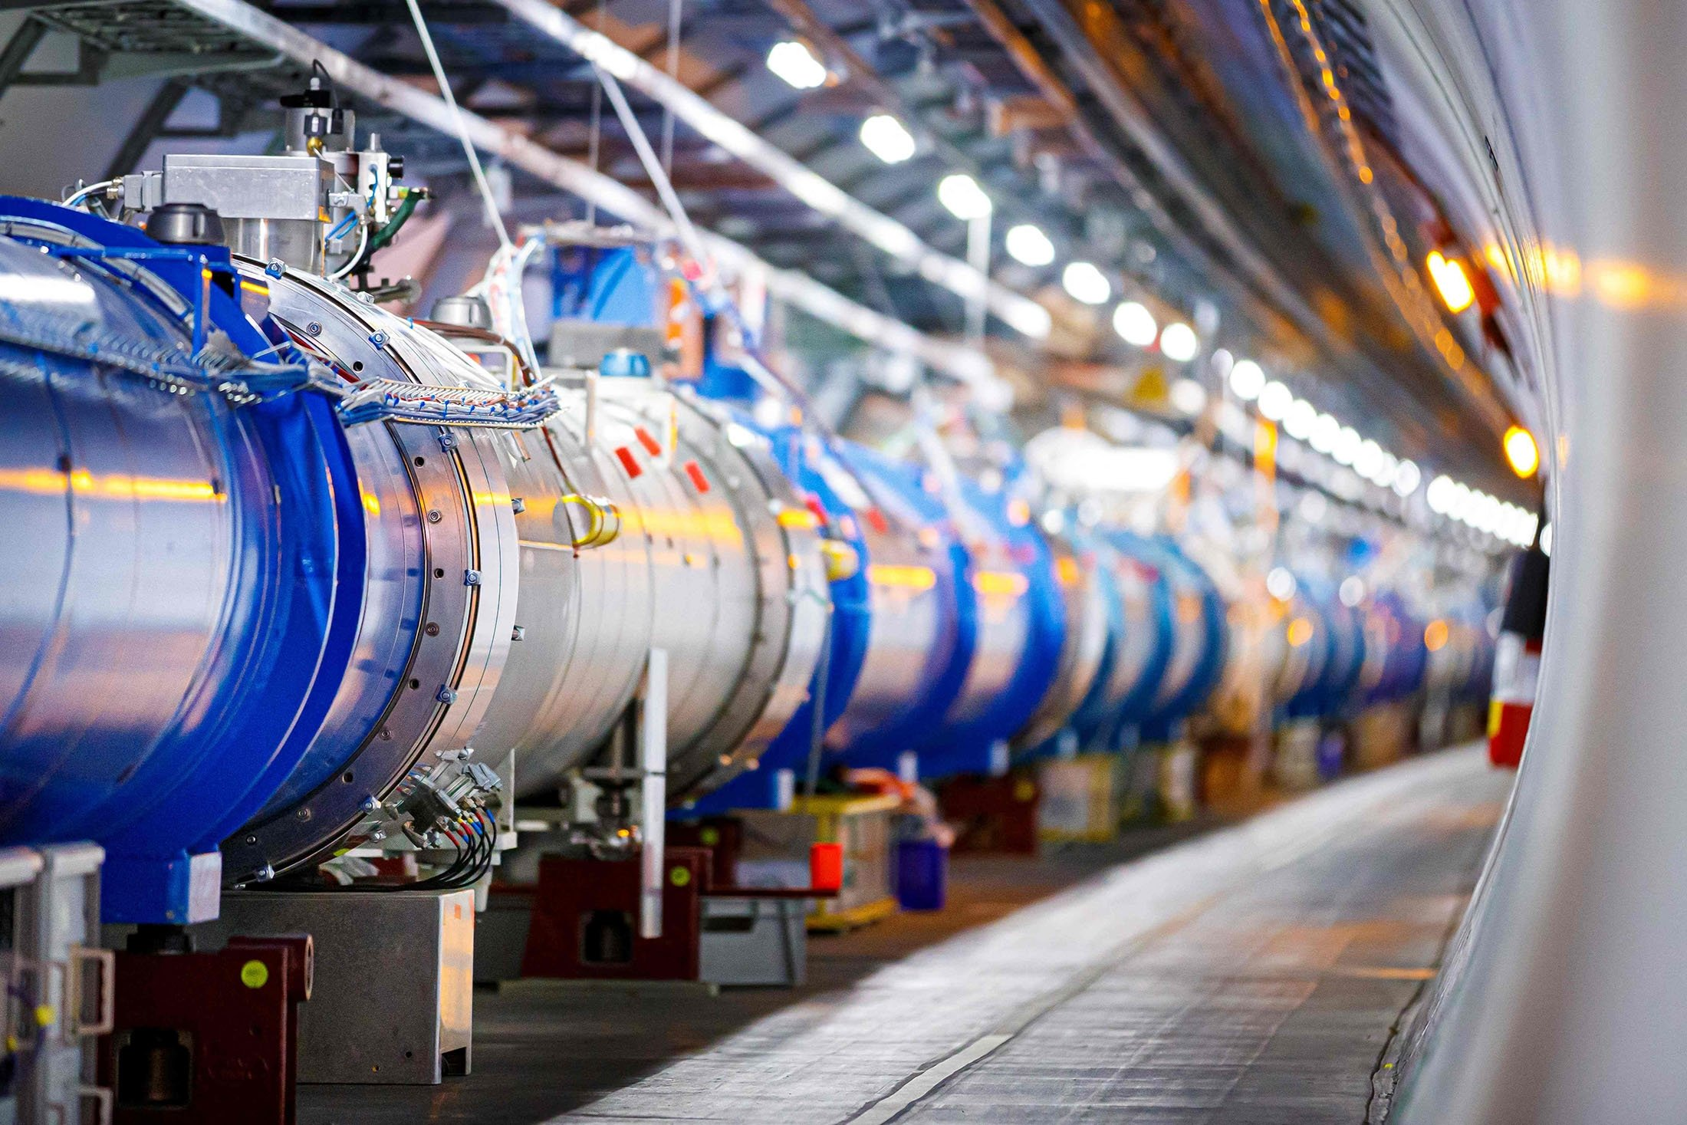
The Emergence of Big Science
From “manual production” of scientific data to the “industrial revolution”
1920-40 : Small experiments by few individuals, slowly growing
1960-: Big Science, costing $1B+, take decades, very risk-adverse, thousands of people
This is a big difference
Past: Experiments rapidly followed one another, data sets had a short life
Today: Big Science experiments (LIGO, LHC, SKA, LSST, OOI, NEON,…) may not be surpassed by another variant in our lifetime
SSC ☹
Van der Graaf -> Cyclotron -> Synchrotron -> National Labs
LHC ☺
It will take the whole world to build the next Big Science experiments…

Slide 5
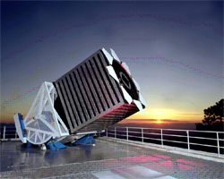
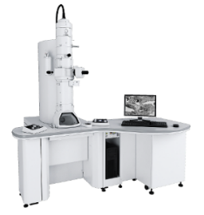
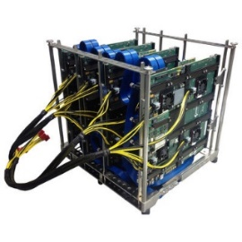
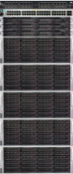
Today’s Science Environment is Mid-Scale
For a long time science funding was bimodal, small PI projects vs Big Science
It is quite different today – more in the middle
Private foundations, public-private partnerships (SDSS, PFS, …)
Create a unique instrument, use cutting edge technology, take risks, push budgets to the limit (and beyond) to maximize science, generate large amounts (petabytes) of data
Enormous fresh energy liberated!
Agility – important because of the exponential technology growth
Highly automated, robotic experiments – the next step in scientific data acquisition
At the “sweet spot” for science
Do computations on a shoestring, opportunistically
But: “first meter” problem
TEM
FPGA
In this new computing model, it does not matter where computations are done

Slide 6
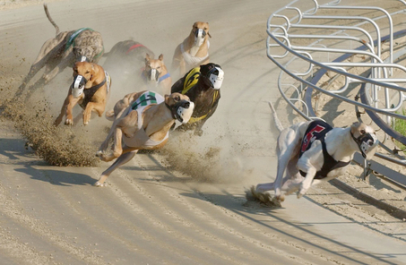
Agility vs Tenacity – How Can We Compete?
Extremely agile changes in the industry (particularly in AI)
Google, Facebook, Amazon, Microsoft
Universities cannot compete with the industry in agility
Faculty hires are for 40 years…
Or in number of GPUs deployed…
But we can compete in tenacity and high-value data!
Mid-scale projects emerging at Universities => generating petabytes
Innovative uses of AI will optimize experiments (-> sensors) and discover new patterns
This requires the data sets to be “AI-ready” (-> tensors)
Most breakthroughs come from a unique data set (Human Genome, SDSS, ImageNet) – combined with disruptive ideas

Slide 7
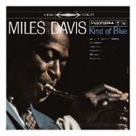


Scientific Data Analysis is Evolving…
The evolution of the music industry is a good example:
LP/CD
=> iTunes
=> Spotify/Pandora
What are the data equivalents?
Download all data
Send tapes, disk, sneakernet
=> Run queries at project servers
Astronomy SQL archives, SkyServer, IVOA, MAST, NED,…
Google Colab,
HuggingFace, JHU SciServer
=> Run in the cloud, view the result
Scientific data and software needs to be Analysis Ready and Cloud Optimized (ARCO)
Ryan Abernathey (Columbia)

Slide 8
Implications of Big Data
Big Data needs parallelism: many similar, inexpensive devices
This scale-out is everywhere, like cloud computing
Same in experiments, many similar cheap sensors
Phones, wearables, CubeSat…
The relation between computing and data is changing
Computing more CPU intensive as we move from queries to inference
Two kinds of errors: statistical and systematic
Statistical errors decrease with 1/$\sqrt{N}$
However, similar is not identical!
Systematic errors: subtle instrumental biases
If obvious, we call it calibration, and do it
If not, it remains often undetected
But: these can be corrected in software, much cheaper overall!
Particularly important for AI training sets (“garbage in, garbage out”)
Systematic errors are the hardest problems in experimental scaleout!

Slide 9

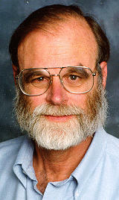
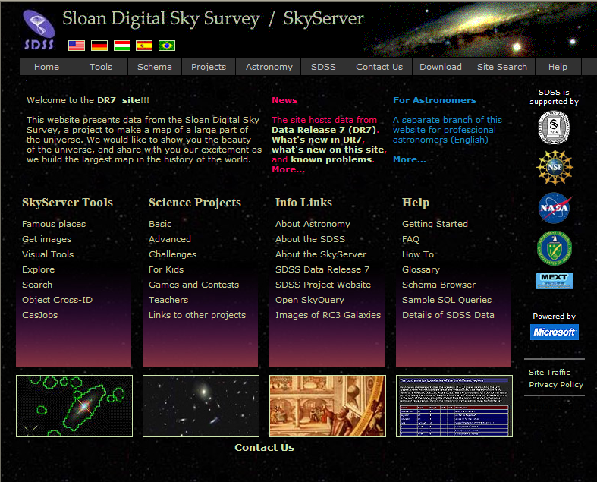
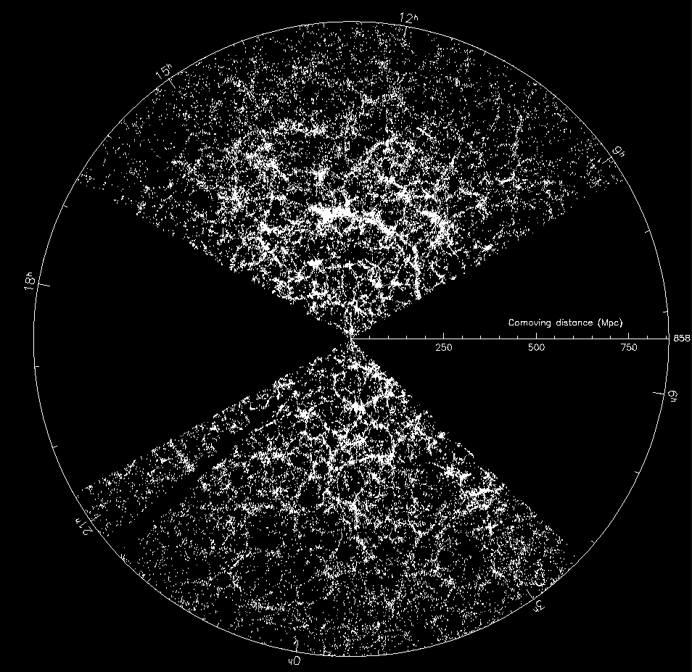
Mid-Scale Example: Sloan Digital Sky Survey
“The Cosmic Genome Project”
Started in 1992, SDSS-II finished in 2008
Data is entirely public, open and free
Database built at JHU
Project marked a transition in astronomy
From manufacturing to mass production
Jim Gray
SkyServer: Prototype in 21st Century data access
Visual interface integrated with object-relational DB
Remarkably fast adaptation by the community
10M distinct users vs. 15,000 astronomers
The emergence of the “Internet Scientist”
Collaborative server-side analysis
Still the world’s most used astronomy facility
Scientists become publishers and curators of large data!

Slide 10
Main Concepts in the SDSS SkyServer Design
Requirements definition via “20 queries”
Apply the 80-20 rule: do 20% of all things that make 80% of users happy
Focus on enabling new discoveries!
SQL backdoor enabled (to-date 950M free-form SQL queries ran)
Reproducibility: preserve hyperlink to raw data
Annual versioning (DR*, accompanied by paper in journal)
DB integrated with a visual, interactive interface
High performance spatial index built on spherical quadtrees
Full query log available for CS research
Always go from working to working!

Slide 11
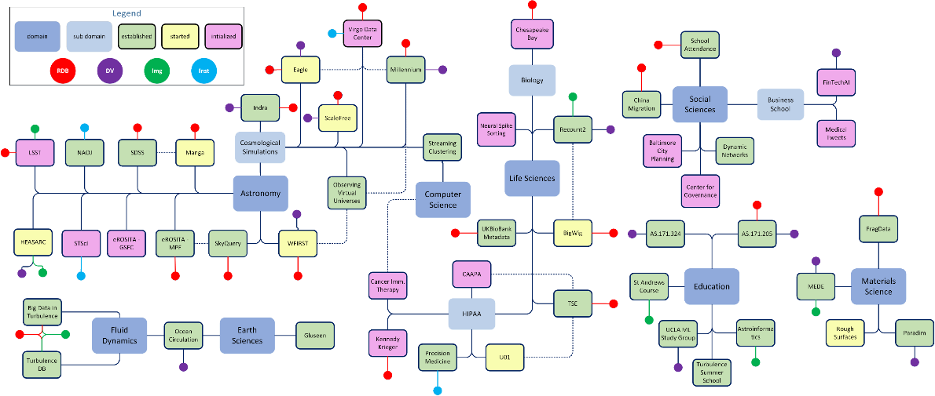

From SkyServer to the SciServer
Provide “disruptive assistance” -- from “patterns to processes”
Institutionalize “lessons learned” in a multidisciplinary setting
Convergent, multidisciplinary engagements (70+ ongoing projects)
Hosted on the SciServer – collaborative platform for petabytes of data
Collaborations with national labs, federal agencies (NASA, NIST, DOE), Max Planck
Broad innovative educational and outreach program
Leverage our scalable open infrastructure
Currently 30PB+, 200 servers
10M casual users, 10K+ power users
Operating at very good economies of scale
Increasing use of AI tools
Don’t try to do everything for everybody: find the right tradeoffs!

Slide 12
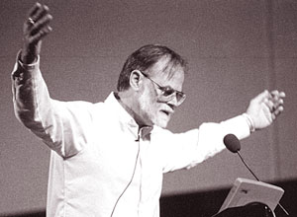
Astronomy Adopted to Open Data Very Fast
Astronomy was always data-driven….
We cannot experiment with stars in the lab…
“Very exciting to work with astronomers, since their data is ‘worthless’!”
— Jim Gray to Bill Gates (~2003)

Slide 13

Data Analysis/Processing is Multi-tiered
Several processing steps occur after data collection
Calibration
Iterative correction of systematic errors
Federation of multiple data modalities:
Cross-matching: fuzzy spatial joins between distinct object classes
Every user does the join by different criteria
We gain a lot of new information, but there is also some loss
Multiple ways of cross-referencing
Introducing a new kind of error
Things are gained, but some things are also lost in translation

Slide 14
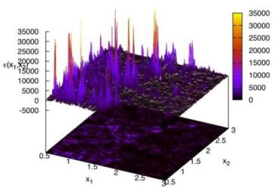
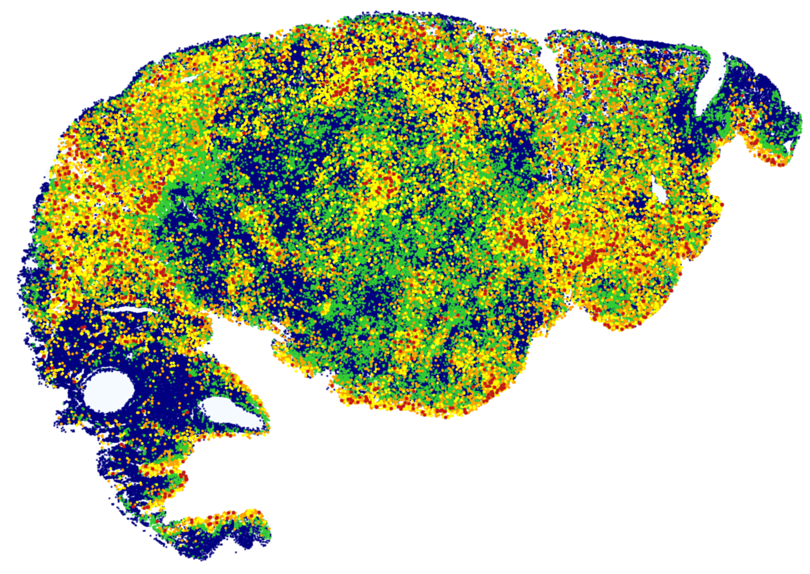
Mid-Scale Science => “Game Changing” Data
Leapfrog – “non-incremental” – but still Mid-Scale Science – Similarities
(2001- ) Sloan Digital Sky Survey (SDSS) – grew data by a factor of 100, still the world’s most used astronomy facility, 4.6B web hits, 713M SQL queries, 10M users, 15K papers, 770K citations
(2006- ) Turbulence database (JHTDB) the world's largest simulations, the "virtual observatory" of turbulence, 1PB of data, 550 trillion points delivered to the world, used by NVIDIA
(2016- ) AstroPath (JHMI) – 1000-fold increase in data for cancer immunotherapy, astronomy => pathology, soon Open Cancer Cell Atlas with billions of cells 28T pixels, 1B cells
(2017- ) POSEIDON (w. JHU/MIT/Columbia) building the world's largest ocean circulation model, 10x higher resolution, open petascale interactive laboratory 2.5PB of data on its way
Each of these scalable experiments are already serving as training sets forAI

Slide 15
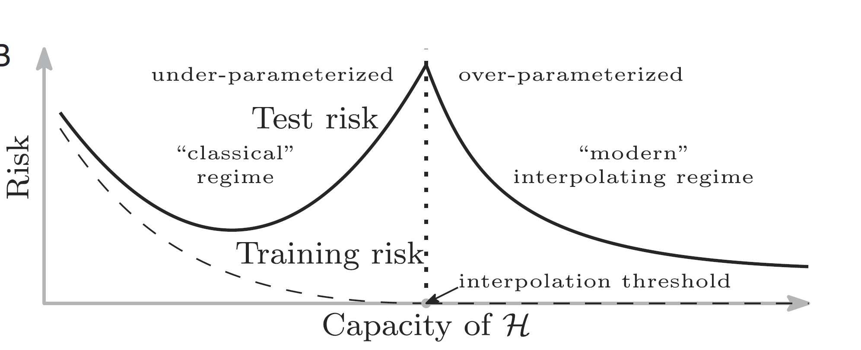
AI in Science Today
Much related to posterior analyses of existing data
Proxy simulations (turbulence, cosmology, climate modeling)
Recognizing patterns (image segmentation, AlphaFold, denoising)
Anomaly alerts
Recent developments with LLMs
They can recite much of the literature
Code generation is becoming popular
Why are “over-parametrized” models stable?
Zero-shot, fine-tuning, LoRA
– why and how does it work?
Belkin et al 2019 PNAS

Slide 16

Need Explainable AI
Scientists do not like Black Boxes
We need to know what is happening inside and its significance
Physics of AI is emerging in interpreting the evolution of the complex networks (has its roots in spinglasses)
The initially random weights of a network develop long range correlations during learning – like a phase transition
Identify symmetries in the underlying problem
Latent layers of the autoencoders
Interpretable autoencoders emerging (Regev et al)

Slide 17
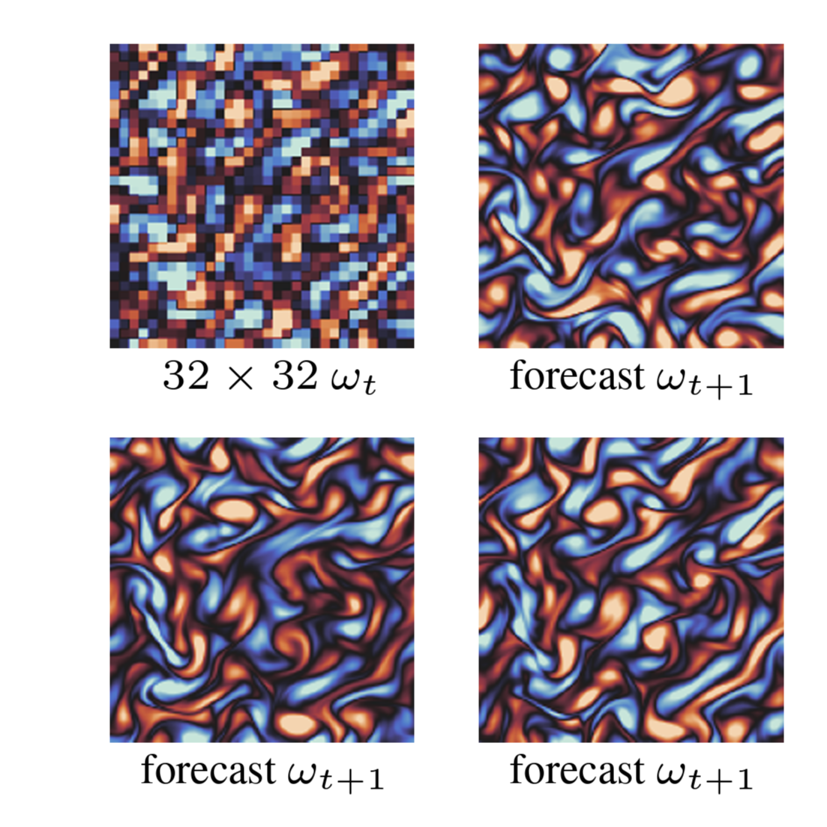
Superresolution forecasting by AI
Proxy simulations:
Generative models using stochastic forecasting
Climate, turbulence, cosmology
Similar to diffusion models
Multiple equally plausible outcomes
“Superposition” of these states
➔ a “diffusion error” emerges
It is not even an error, but a new systematic uncertainty
Probabilistic Forecasting with Stochastic Interpolants
Y.Chen etal 2024

Slide 18
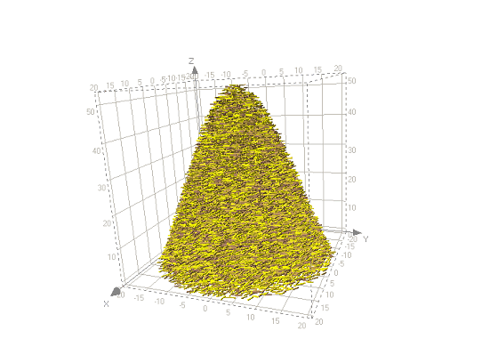
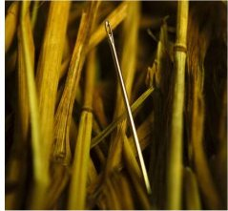
Prioritizing Data Collection
Delicate tradeoff between the scientific value and the cost of preservation
One extreme – store everything, go bankrupt!
Other extreme – collect too little data, not enough for the science!
LHC lesson
“Do you have enough data or would you like to have more?”
We do not know what the needle looks like, but we know the hay!
In-situ (AI) hardware filters data, optimizing for “new science”
Only 1 in 10M events saved (9999999:1)
Resulting “small subset” is still 100 PB
Tradeoffs are essential: cannot do everything for everybody (9-1, 99-1 or 999-1?)

Slide 19

Stratify and Compress with Generative AI
Use Generative AI to learn the corpus of known science for a given experiment, using fine-tuning/LoRa
Build AI tools to recognize if incoming data is inside the affine hull of the known parameter space
Use this to downsample, or compress using the parameters of the generative model and create well-stratified data sets that represent the UNKNOWN domain without breaking our budgets
Recognize and correct/calibrate for systematic errors
Optimize experimental strategy to maximize science goals
AI can have a much bigger impact on our experiments than on our analyses!

Slide 20


Collect More RELEVANT Data!
Need to dramatically improve our experimental design…
Artificial Intelligence in large-scale experiments: use AI before and while we collect the data
It is already happening at CERN, material science, drug design, astronomy
Adaptive target selection, active learning, Gaussian processes
Maybe this will be the Fifth Paradigm, algorithms control our experiments => also make intelligent, real-time decisions
Put the telescope in the reinforcement loop!
Supported by the Schmidt Sciences at JHU and Princeton: Use AI Feedback for the PFS project
If an AI algorithm can drive our cars, why cannot it run our telescopes?

Slide 21
Challenges: Data Locality
We will never have all data that we need located at the same place
E.g. Sky Surveys/ Virtual Observatory, Government data, Medical data
Yes, we can finally move data fast on PB scales
But not that fast if we have few 100 PB
Eventually all scientific data will move to the cloud (~5-10 years)
But: they will be spread in different clouds
Simply moving the data to one place is not viable
E.g. Egress fees
We will need to do efficient fuzzy set comparisons across boundaries
Must be log N in the difference
Or exchange course-grain sketches of data
Or exchange network weights (federated learning/training)

Slide 22
Challenges: Reproducibility!
Reproducibility is very hard today...
But, we thought at least we understand what it is
Maybe we don’t…
If the analysis of every experiment running through AI is inherently stochastic, what does reproducibility mean?
We need to redefine reproducibility for AI related analyses (and experiments)

Slide 23
Summary
The only way for academics to stay relevant is to collect more unique data!
The data must be AI-ready (from sensors to tensors!)
Many challenges remain: collection, analysis, preservation, reproducibility
AI will optimize our experimental strategy to maximize science goals
AI driven experiments around the corner (with the AI in active control)
New types of uncertainties emerging
AI is the Quantum Mechanics of computing – everything is probabilistic
The relation of computing to big data is changing:
From queries to inference => much more cycles per byte of data (super-Amdahl)
Generalization
This new world will take some time to adjust to…

Slide 24
