Slide 1

Enabling LLMs To Reason Beyond THEIR TRAINING DATA
Kaustubh Vaghmare

Slide 2

About Me
PhD. In Astrophysics from IUCAA
  Photometry and Spectroscopy of S0 Galaxies and Pseudobulges
  Virtual Observatory
Project Lead and Data Scientist @ IUCAA
  Astronomical databases, data services
  Data management and Virtual Observatory
  Applying AI / ML to Astronomy
Now, a Senior Architect @ ML Competency @ Persistent Systems
  Applying AI to business problems (cybersecurity, B2B, Healthcare, Pharma, and BFSI)
  Specialist in Machine Learning Operations (MLOps)
  Generative AI Solutions Architect
Kaustubh Vaghmare
Follow Me:
vkaustubh.github.io

Slide 3
The FlightPlan
Rapid recap of LLMs
  What they can and cannot do?
Retrieval Augmented Generation (RAG)
  Concepts
  RAG Workflow and Pipeline
Applications
Challenges
Measuring Performance of RAG Pipelines
Future / Recent Present (if time permits, it mostly won’t)
  Multi-Modal
  Agentic

Slide 4
Quick Review of LLMs
Laying the Foundation

Slide 5



How do you get computers to understand and generate natural language?
Sparse high dimensional vector representations.
Apples and fruits have no relationship.
Well, a sentence is not simply a bag of words.
Bag of Words
Low dimensional vector representations where apples and fruits relate.
Still doesn’t honour the sequential nature of natural language.
Embeddings
Address sequential processing but…
Suffer in capturing long range dependencies
Cannot be parallelized.
(Self, Multi-headed)
Attention
Recurrent Neural Networks
Transformer Architecture

Slide 6


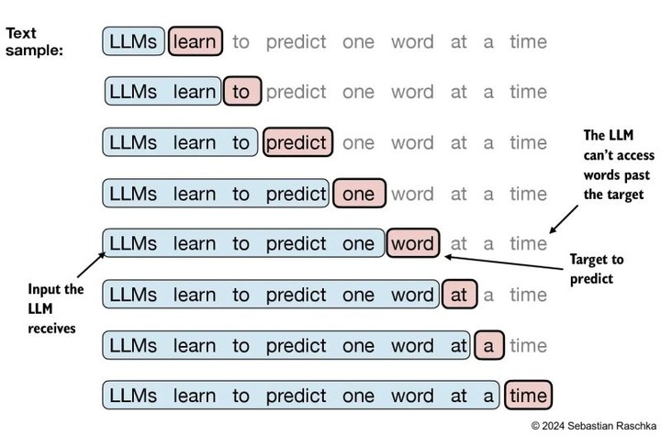
Generative Pre-trained Transformer (GPT)
Huge Text Data
(CommonCrawl, The Pile, and more)
Foundation Model

Slide 7

Instructions | Output
Fine Tuning
What is the capital of France?
What is the capital of France?
What is the capital of India?
Foundation Model
What is the capital of France?
What is the capital of France?
The capital of France is Paris.
New Model

Slide 8
What is the capital of France?
The capital of France is Paris.
What questions can LLMs
answer or reason about?
What are the top 3 products by gross income of my company?
What is the travel reimbursement policy for conference invitees in X?
As this information wasn’t part of the
training data, LLMs are unlikely to answer.

Slide 9
How do you get LLMs to reason beyond their training data?
Fine Tune Over Private Data
Retrieval Augmented Generation
Expensive!
Not fool-proof.
Needs to repeat as data continues to pile up.
Trust issues.
Much less Expensive!
Higher chance of grounding (but…)
Can work with latest data without substantial work.
Can provide information sources, thus building trust.

Slide 10
Retrieval Augmented Generation

Slide 11
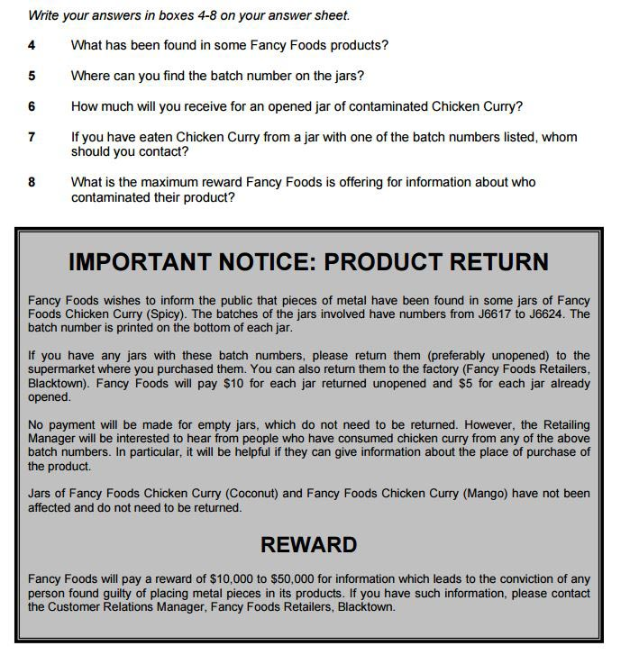
Source: Cambridge English IELTS Past Papers

Slide 12

<Augmented Context>
(Reference Material)
<Your Question>
<Your Question>
Private Source 1
Retrieval
Of material relevant to the question
Private Source 2
Private Source 3
Final Answer…
…
Generation

Slide 13


IMPLEMENTING A RAG WORKFLOW – Preparing The Data
Parse, Clean, and
Chunk
Source Documents
Embed
Vector Database
What is Chunking?
Chunking = breaking text into smaller pieces
Chunk = text + metadata of text
Why Chunking?
To honour the context window size (limits and costs)
To make embeddings more accurate.
A note on Embedding
The entire chunk is embedded i.e. converted into a vector.
Special models are used for this which pay attention to the meaning of a text fragment (and not just a word)
Choosing an embedding is a critical step.
What are Vector Databases?
These are store houses designed for efficient storage and retrieval of vectors (embeddings).
They store typically
  Embedding
  Original text
  Metadata

Slide 14


The RAG Pipeline
Retrieval / Search
Vector Database
Query
Vectorize
Retrieved Chunks
Final Generated Response
<system prompt>
<context>
</context>
Query:
LLM
Prompt post Retrieval and Augmentation

Slide 15
Applications of RAG
Advanced QnA
Content Creation
Summarization
Recommendation Systems
Semantic Search

Slide 16
The RAG Pipeline
Retrieval / Search
Vector Database
Query
Vectorize
Retrieved Chunks
Final Generated Response
<system prompt>
<context>
</context>
Query:
LLM
Prompt post Retrieval and Augmentation

Slide 17
Challenges of RAG – Summarized
Source | Alleviations
Query | User training Interactive Reformulation
Vectorization Process | Domain specific embeddings Preprocessing before embedding
Retrieval Process | Observability Advanced Retrieval Techniques
Chunks | Ingestion-time or Retrieval-time processing of chunks Reranking
Prompt | LLM-specific prompt engineering Prompt chaining
LLM | Re-training or fine-tuning Alternate models

Slide 18
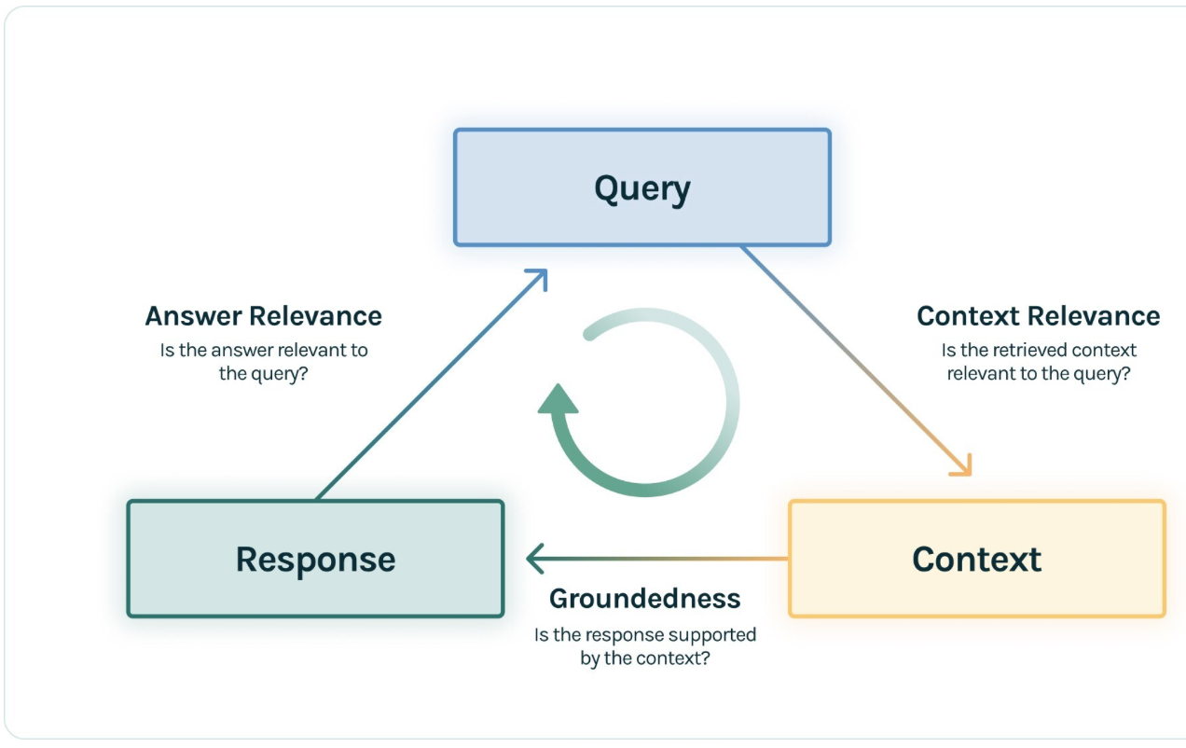
Measuring RAG System Performance
Ground Truth Answer
Credit: TruLens

Slide 19
The Recent Present / Future of RAG
Multi-Modal and Agentic RAG

Slide 20
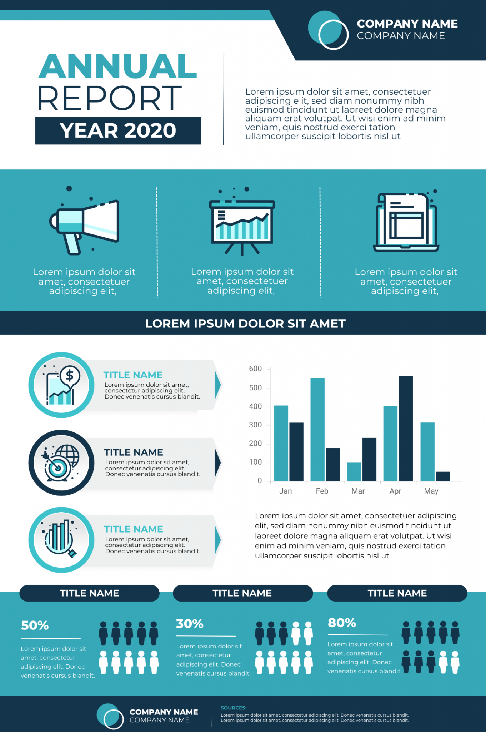
Multi-Modal RAG
What are the key highlights of 2020?
What is the projected growth in 2021?
What has the trend been in the past 3 years?
…
To answer the above questions, we cannot just use an LLM. We need something that can combine information from
Language
Image
(Audio / Video)

Slide 21
Two Ingredients of Multi-Modal RAG
Multi-modal Large Model
Multi-modal RAG Pipeline
These are trained on large datasets containing data from multiple modalities – text, images, audio, and/or video.
The model then learns patterns across modalities and can reason across them.
The embedding layer is replaced by one which
Creates individual embeddings for each modality
And aligns them in a common space.

Slide 22
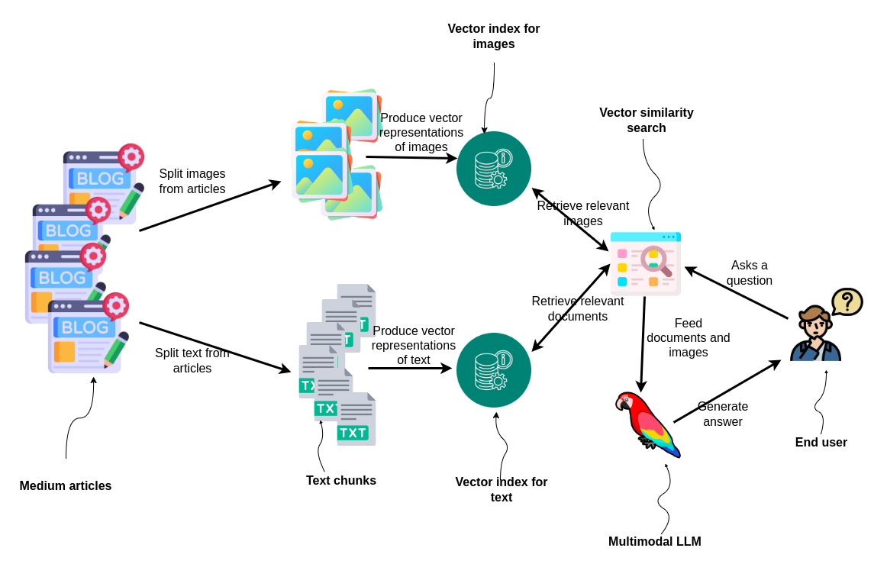
Image Credit: LlamaIndex

Slide 23
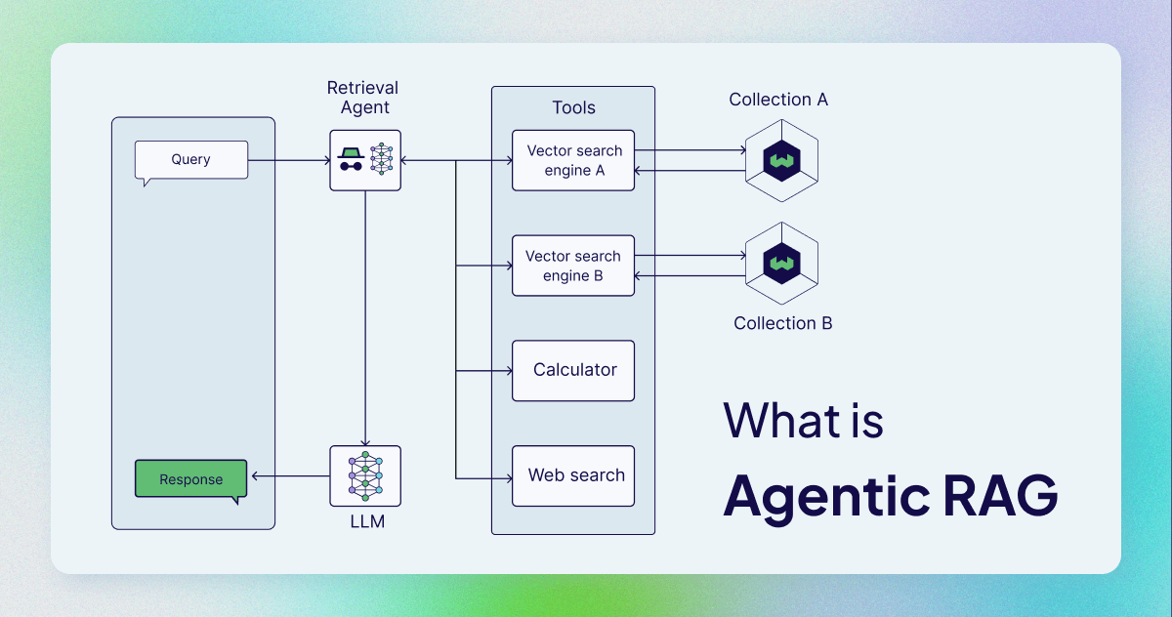
Credit: Weaviate

Slide 24
Thank You!

